Slide 1
Finish off ending Week 1-3
L1 – Grammar- recognising directed speech
L2- Punctuating direct speech-
L3- Vocab
L4 – Gather ideas (story maps)- Para 1 (describe journey to the islands on the boat)
L5 – Para 2 (go to island- the setting)
L6- Para 3 (who does he meet that gives him an idea
L7- Applied Grammar (writing direct speech)
L8- Paired Write
L9- Independent Write
L10- Edit and Improve
Destination reader /Book talk
- Human Oliver - what is he like. What is his parents like
Read up until keep out and start guessing whats going to happen
Do nows
Plurals
Punctuation , ! ? .
Time adverbials
Conjunctions

Slide 2
Cycle 2 Week 3-4
Destination reader /Book talk
Elicit her character and her appearance etc
Choosing time
Do nows
Plurals
Punctuation , ! ? .
Time adverbials
Conjunctions

Slide 3
Week 5-7
Look at year 4
Destination reader /Book talk
Elicit her character and her appearance etc
Choosing time
Do nows
Plurals
Punctuation , ! ? .
Time adverbials
Conjunctions

Slide 4
Model- WAGOLL: Character Description of the Witch
The witch had gnarled, crooked hands with long, sharp nails that scratched against the ground. She had a shrivelled, wrinkled face with deep, dark lines and a hooked nose on her pale skin. Her small, fierce eyes with a cold, menacing glare stared out from under her heavy, shadowy brow. Her spindly, twisted body in a long, tattered cloak crept slowly through the dark, silent forest. The witch let out a loud, cackling laugh with a harsh, echoing sound that rang through the trees. Her thin, bony fingers with blackened tips clutched the stolen happy endings tightly in her claw-like grip. She moved like a shadow, silent and menacing, hiding in the darkness. The witch was a villainous, wicked creature with a heart full of darkness.

Slide 5

Stick this in your book
Notes:
Every time the children start a new book, they stick in the front cover
Print and trim it
Give them 3 minutes – they do this In silence – walk around the rook and check

Slide 6

Wednesday 4th September 2024
Monday 8th June 2026​
Gather ideas Story Map 1

Slide 7
Do Now
Look at the sentence below:
The small cat ran quickly down the street.
Your tasks:
Circle the adjective (a describing word).
Underline the verb (the doing word).
Rewrite the sentence and improve it by adding:
  one new adjective
  one stronger verb

Slide 8
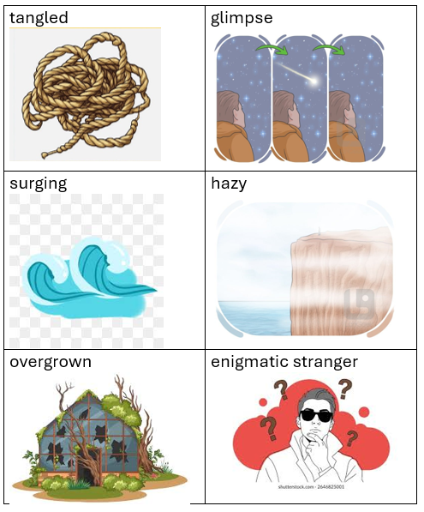

Vocabulary:
Notes:
Each cycle of writing – the children learn new vocabulary to support them with their writing.
You choose 8 worda and make a word document shown on the slide
Every lesson you do a my turn your turn and say the words and get the hcldrne to repoat them
Sa it loud, whisper it, girls say it etc
As the writing cycles get sinto day 4/5 the children know the meaning of the words and you can play very quick games

Slide 9
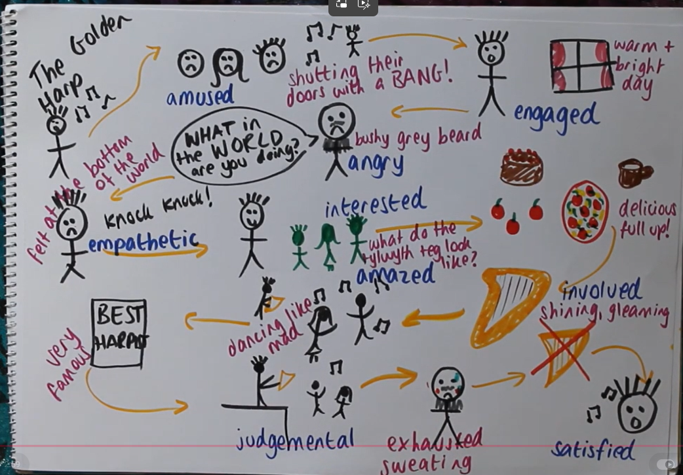
What is a story map? - https://www.youtube.com/watch?v=FwUw2avvhic
Notes:
https://www.youtube.com/watch?v=FwUw2avvhic

Slide 10



Icons used in a story Map

Slide 11
I do

Slide 12
We do

Slide 13
You do

Slide 14
Wednesday 4th September 2024
Tuesday 9th June 2026
Story Map 2

Slide 15
Vocabulary:
Notes:
Each cycle of writing – the children learn new vocabulary to support them with their writing.
You choose 8 worda and make a word document shown on the slide
Every lesson you do a my turn your turn and say the words and get the hcldrne to repoat them
Sa it loud, whisper it, girls say it etc
As the writing cycles get sinto day 4/5 the children know the meaning of the words and you can play very quick games

Slide 16
Do Now
1. Plurals
Change these words into plurals:
fox → ______
baby → ______
box → ______
2. Prefixes (add un- or re-)
Fill in the blanks:
___happy
___do (do again)
___kind

Slide 17
Recap- Icons used in a story Map

Slide 18
I do

Slide 19
We do

Slide 20
You do

Slide 21
Wednesday 4th September 2024
Wednesday 10th June 2026
Story Map 3

Slide 22
Vocabulary:
Notes:
Each cycle of writing – the children learn new vocabulary to support them with their writing.
You choose 8 worda and make a word document shown on the slide
Every lesson you do a my turn your turn and say the words and get the hcldrne to repoat them
Sa it loud, whisper it, girls say it etc
As the writing cycles get sinto day 4/5 the children know the meaning of the words and you can play very quick games

Slide 23
Do Now

Slide 24
Recap- Icons used in a story Map

Slide 25
Wednesday 4th September 2024
Thursday 11th June 2026
Applied grammar

Slide 26
Vocabulary:
Notes:
Each cycle of writing – the children learn new vocabulary to support them with their writing.
You choose 8 worda and make a word document shown on the slide
Every lesson you do a my turn your turn and say the words and get the hcldrne to repoat them
Sa it loud, whisper it, girls say it etc
As the writing cycles get sinto day 4/5 the children know the meaning of the words and you can play very quick games

Slide 27
Do Now

Slide 28
Wednesday 4th September 2024
Monday 15th June 2026
Paired Write

Slide 29
Vocabulary:
Notes:
Each cycle of writing – the children learn new vocabulary to support them with their writing.
You choose 8 worda and make a word document shown on the slide
Every lesson you do a my turn your turn and say the words and get the hcldrne to repoat them
Sa it loud, whisper it, girls say it etc
As the writing cycles get sinto day 4/5 the children know the meaning of the words and you can play very quick games

Slide 30
Do Now

Slide 31

2) Write the date and title
Wednesday 4th September 2024
Tuesday 16th June 2026
Independent Write

Slide 32
Vocabulary:
Notes:
Each cycle of writing – the children learn new vocabulary to support them with their writing.
You choose 8 worda and make a word document shown on the slide
Every lesson you do a my turn your turn and say the words and get the hcldrne to repoat them
Sa it loud, whisper it, girls say it etc
As the writing cycles get sinto day 4/5 the children know the meaning of the words and you can play very quick games

Slide 33
Do Now

Slide 34
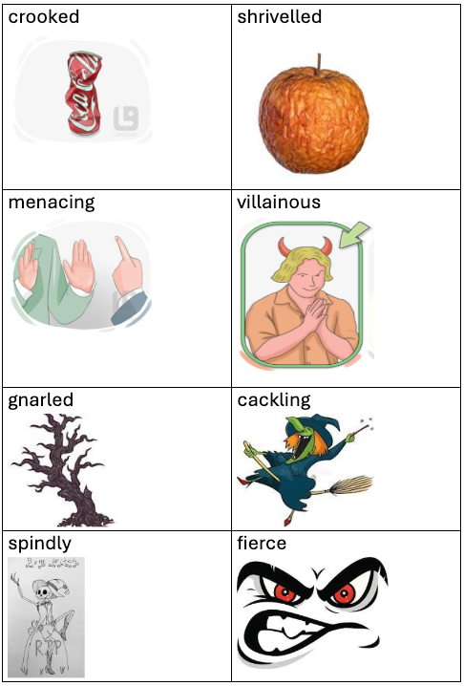

Your turn!
☐ expanded noun phrases (adjective , adjective + noun)
☐ prepositions (with / in / on / under / through)
☐ show not tell
☐ powerful vocabulary words
Challenges
Use similes (like / as)
Use different sentence starters

Slide 35
2) Write the date and title
Wednesday 4th September 2024
Wednesday 17th June 2026
Edit and Improve

Slide 36
Vocabulary:
Notes:
Each cycle of writing – the children learn new vocabulary to support them with their writing.
You choose 8 worda and make a word document shown on the slide
Every lesson you do a my turn your turn and say the words and get the hcldrne to repoat them
Sa it loud, whisper it, girls say it etc
As the writing cycles get sinto day 4/5 the children know the meaning of the words and you can play very quick games

Slide 37
Do Now

Slide 38
Capital letters and full stops

Slide 39
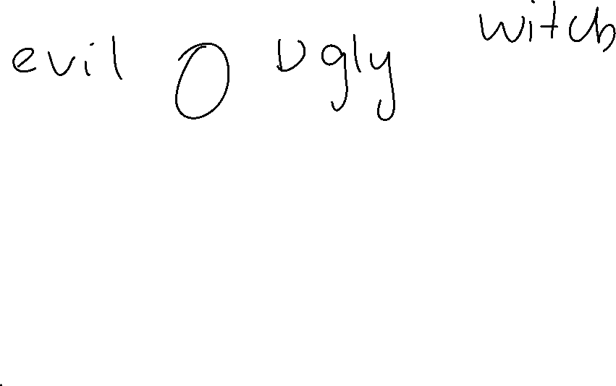
Expanded noun phrase
_______________ , _______________ noun

Slide 40
Handwriting

Slide 41
Spellings
poisonous
poison
horrified
Spat
Night
Rotten
Hideous
Clawed
diamond
moaned
echoed
golden
passed
wail
horror
straw
devil
inch

