Slide 1















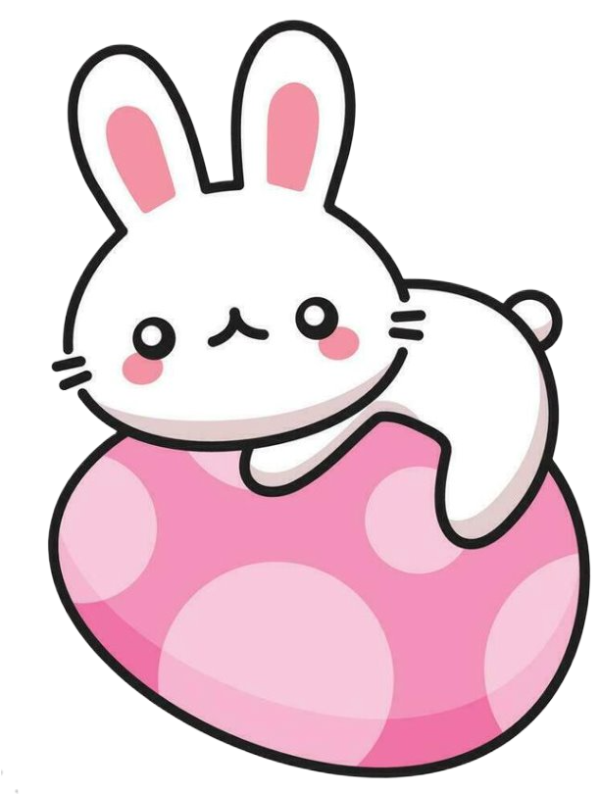
CHRIST
CHURCH
EASTER
FETE
Easter
Bonnet
Parade
Prizes!
arts
And
crafts
Wear
Your
Easter
Bonnet!
Face
painting
Bouncy
castle
Join us in
the playground!
Tea
and
cake
shoppe
THURSDAY
3rd APRIL
2.30PM

