Slide 1
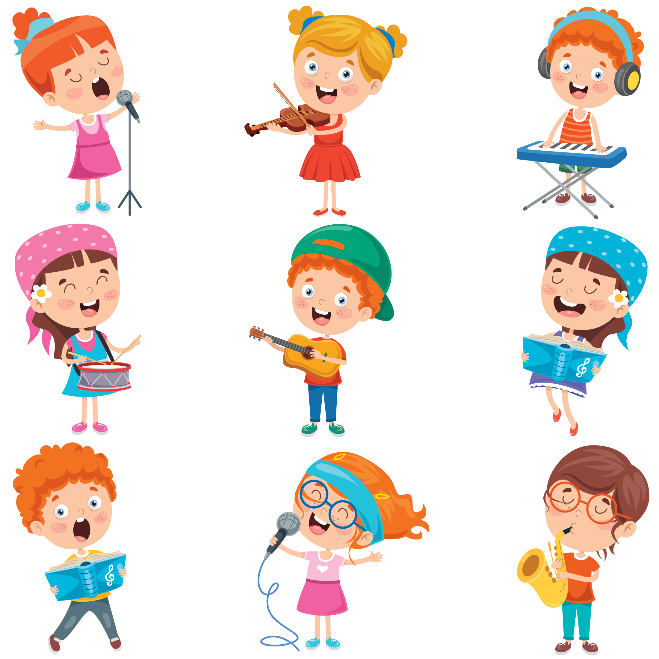
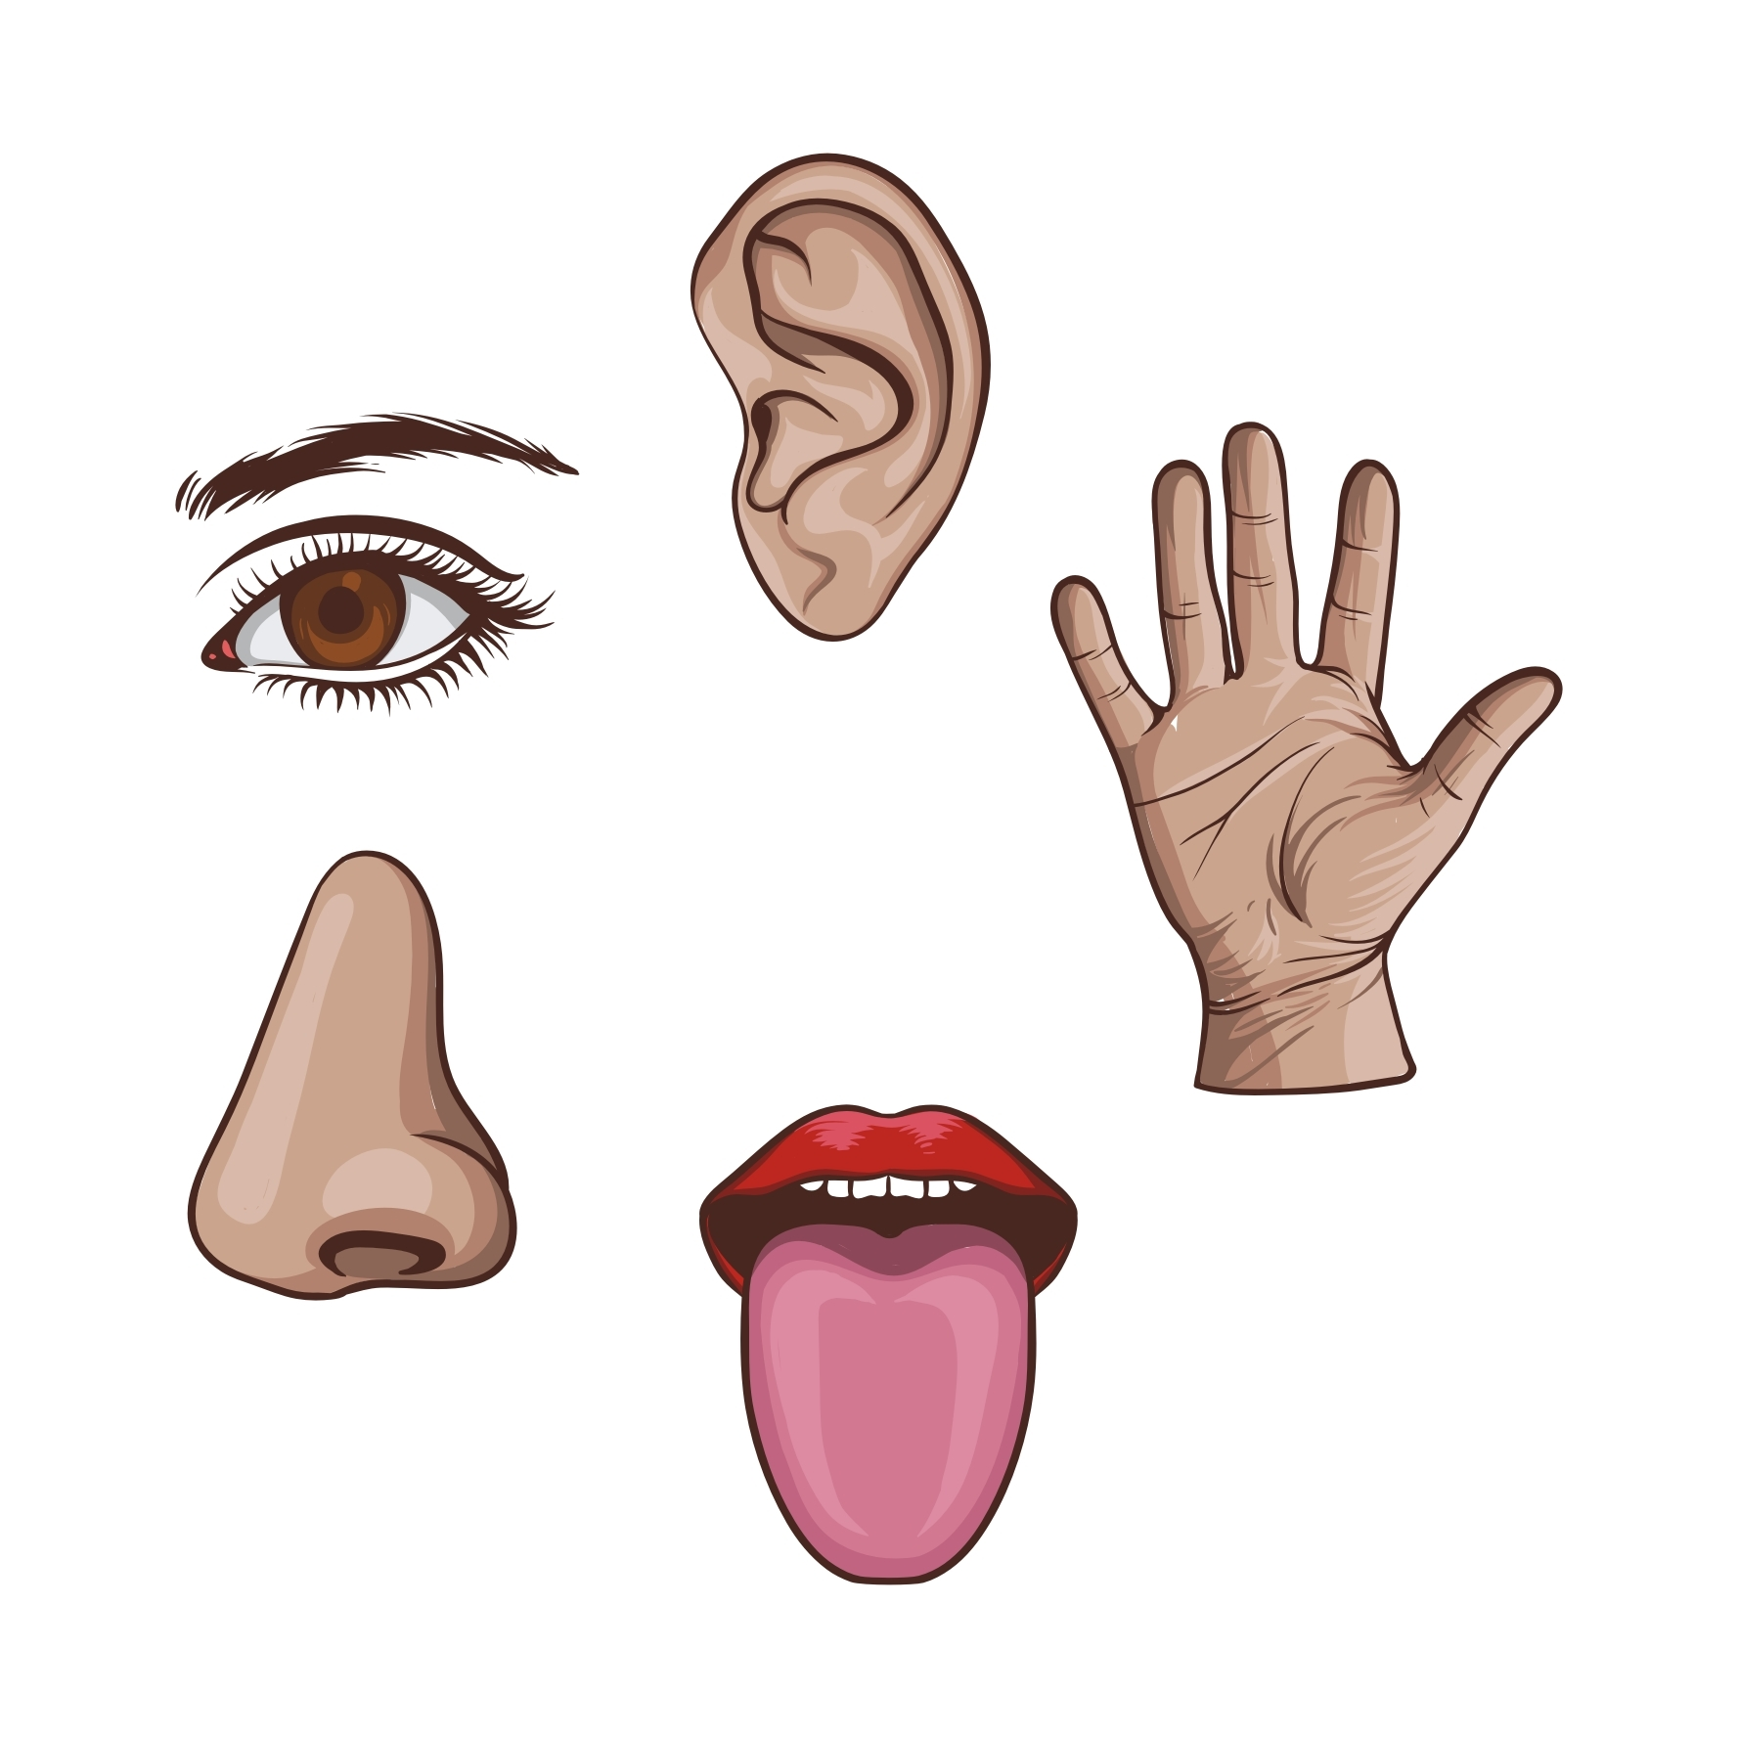
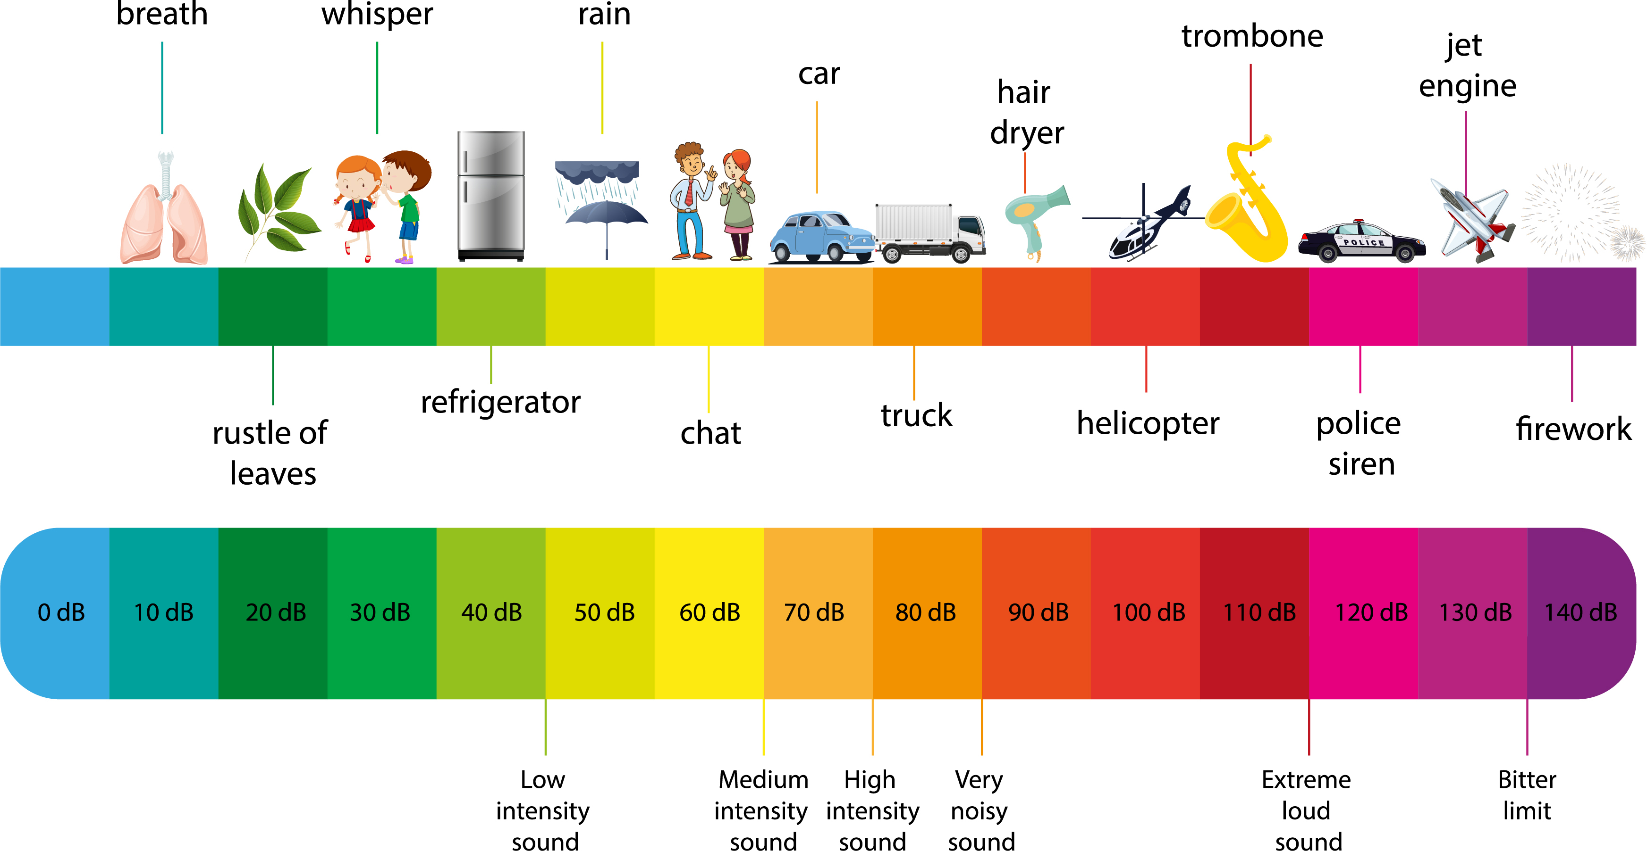
Sound ¦ Year 1 ¦ Spring 2
VOCABULARY
Volume | The loudness of a sound. Loud Sound - Someone shouting Quiet Sound - Someone whispering
Decibels (dB) | Volume is measured in decibels.
Pitch | Whether a sound is high pitch or low pitch. High Pitch – A whistle blowing Low Pitch – A lorry engine rumbling
MAKING SOUNDS
Hitting
Strumming
Blowing
Singing
5 SENSES
Vision Our eyes help us to see things | Taste Our tongue helps us to taste our food | Touch Our hands, feet and skin help us to feel things | Smell Our nose helps us to smell | Hearing Our ears help us to hear sounds
EXAMPLES OF QUIET AND LOUD SOUNDS

