Slide 1


Going to Britian
This Photo by Unknown Author is licensed under CC BY-SA
This Photo by Unknown Author is licensed under CC BY-SA

Slide 2




Advice page 1
Climate
England is a cold country except during the summer and maybe spring it can get hot.
England can get very cold since its way up north witch is colder than west or east or even south.
Appropriate clothing
Winter/Autumn Summer/Spring
A thick winter coat Short sleeve shirt
Wooly glove A coat
Wooly socks Shoes
Wooly jumper Sliders/Slippers
Wooly scarf
Boots
This Photo by Unknown Author is licensed under CC BY-NC

Slide 3




language
The most common language in Britain is English and its actually very easy to learn!
The easiest words are Hi Hello Yes No Bye
But there are also many different languages such as Spanish and French.
This Photo by Unknown Author is licensed under CC BY
This Photo by Unknown Author is licensed under CC BY-SA-NC
This Photo by Unknown Author is licensed under CC BY-SA

Slide 4

Schools
If you have any children you can take them to school.
Schools in Britain aren’t that different from others.
You can learn English Math Science and even more as you are older.
This Photo by Unknown Author is licensed under CC BY-SA

Slide 5

This Photo by Unknown Author is licensed under CC BY-SA

Slide 6
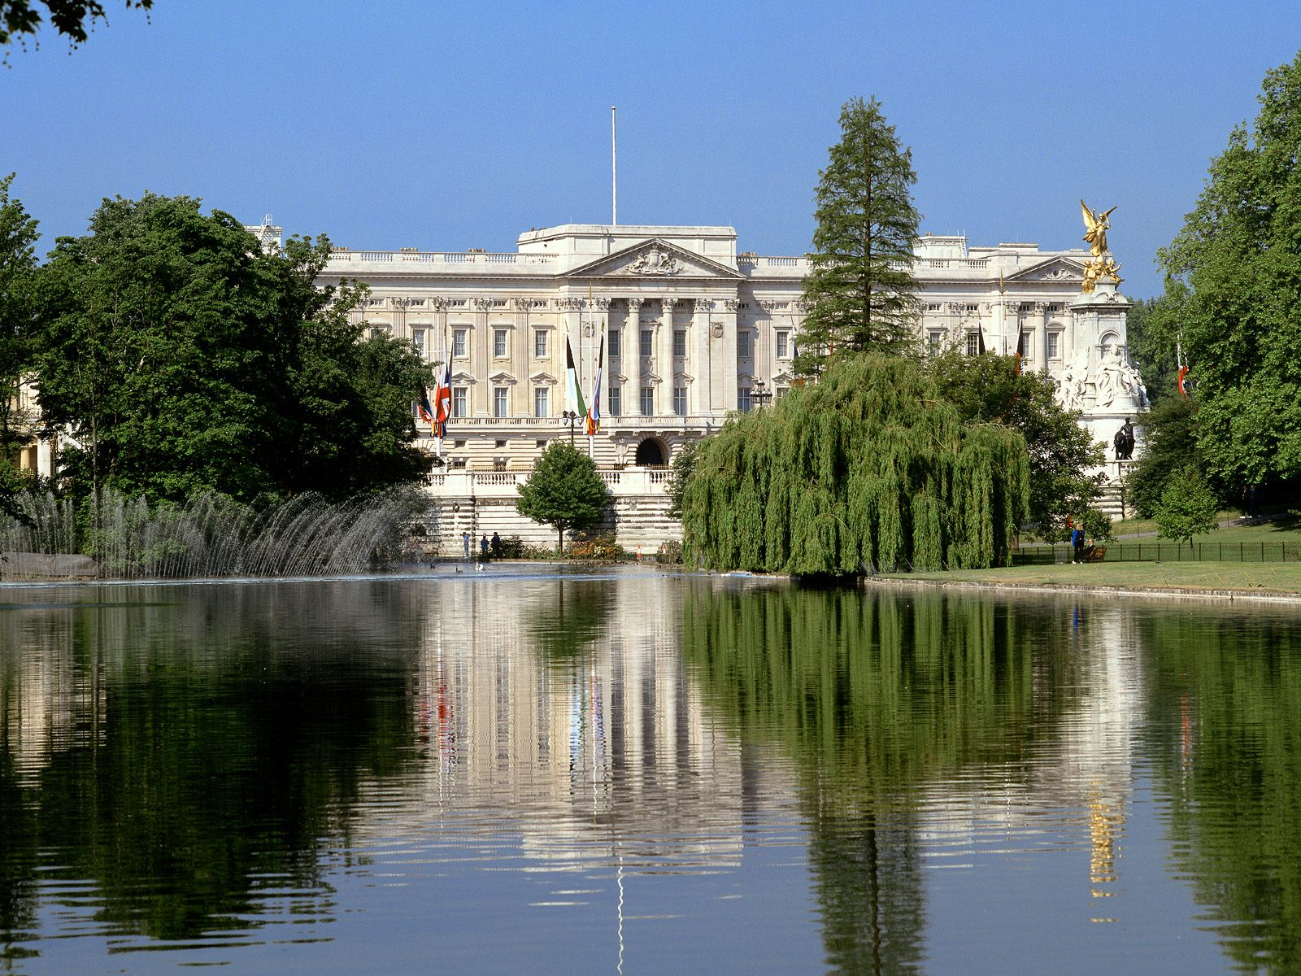
This Photo by Unknown Author is licensed under CC BY-NC

Slide 7
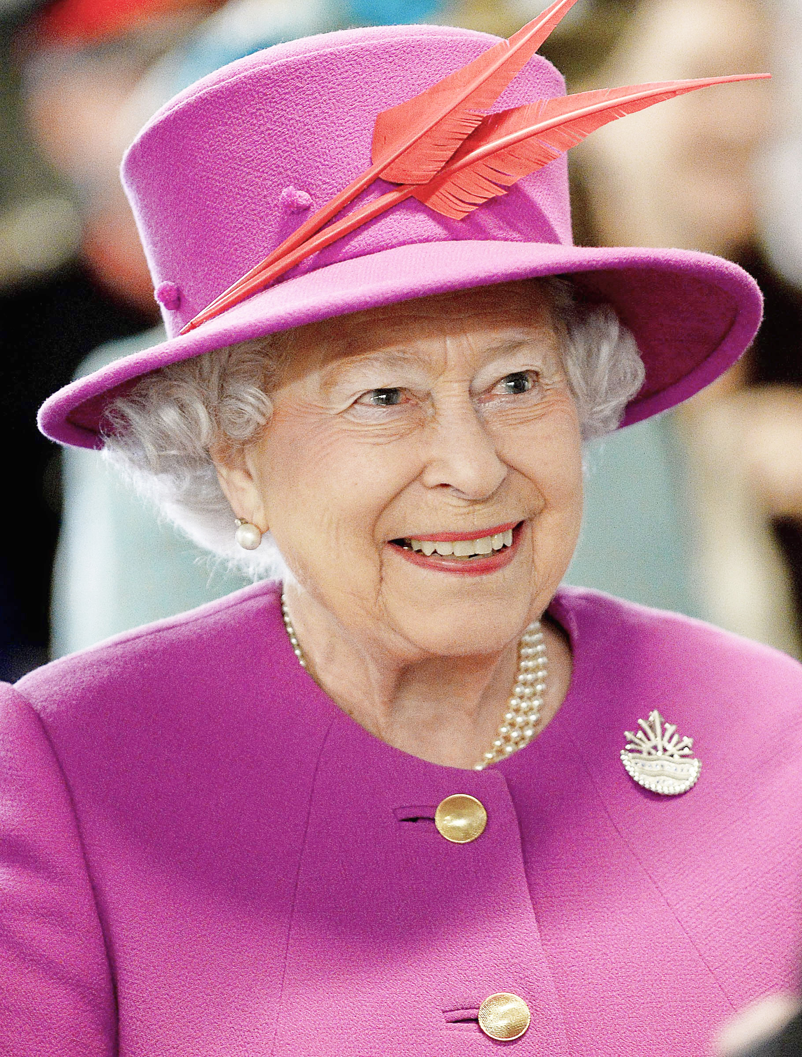
This Photo by Unknown Author is licensed under CC BY-SA

