Slide 1
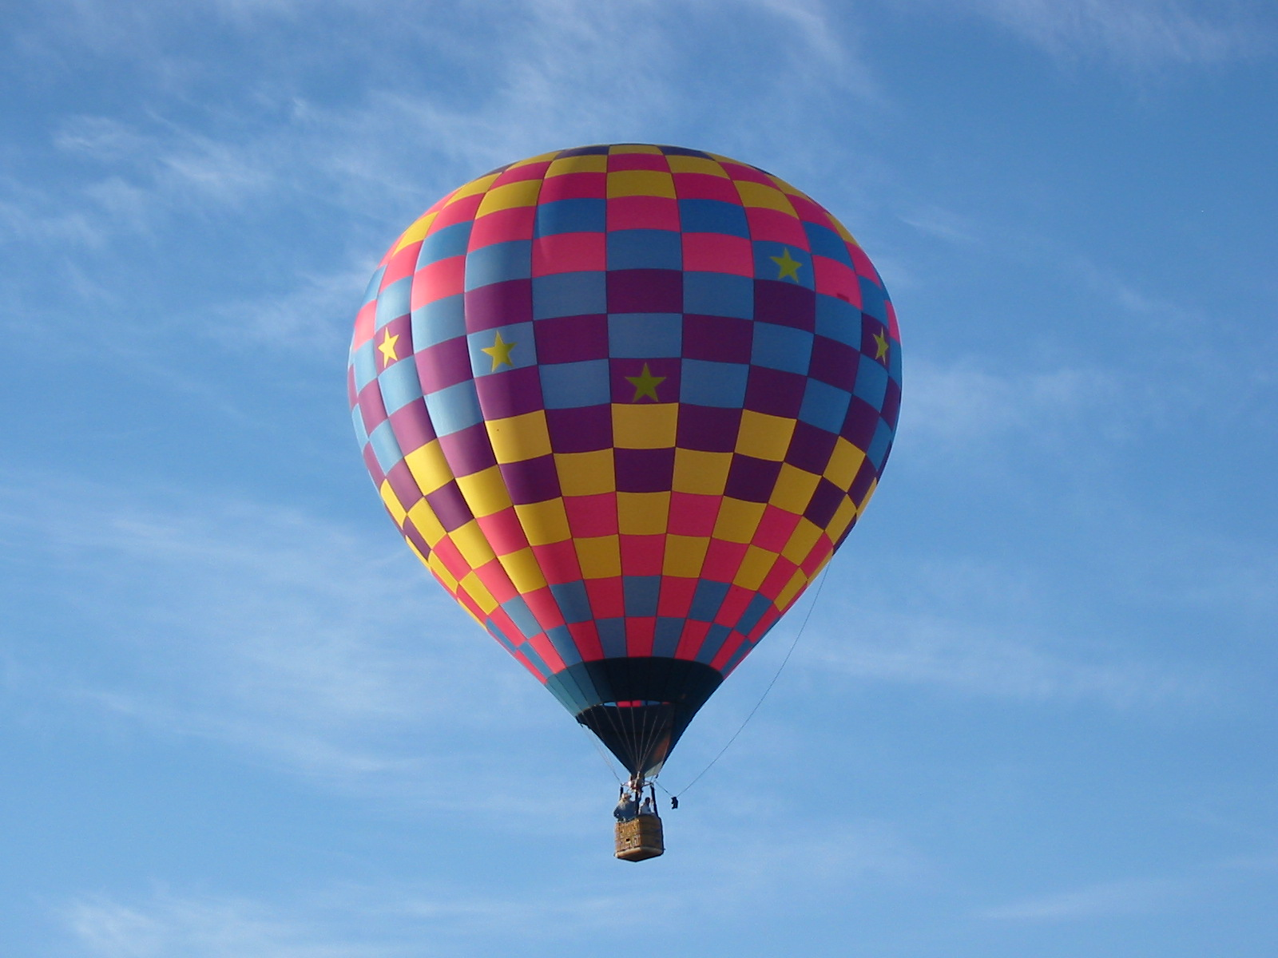

Slide 2
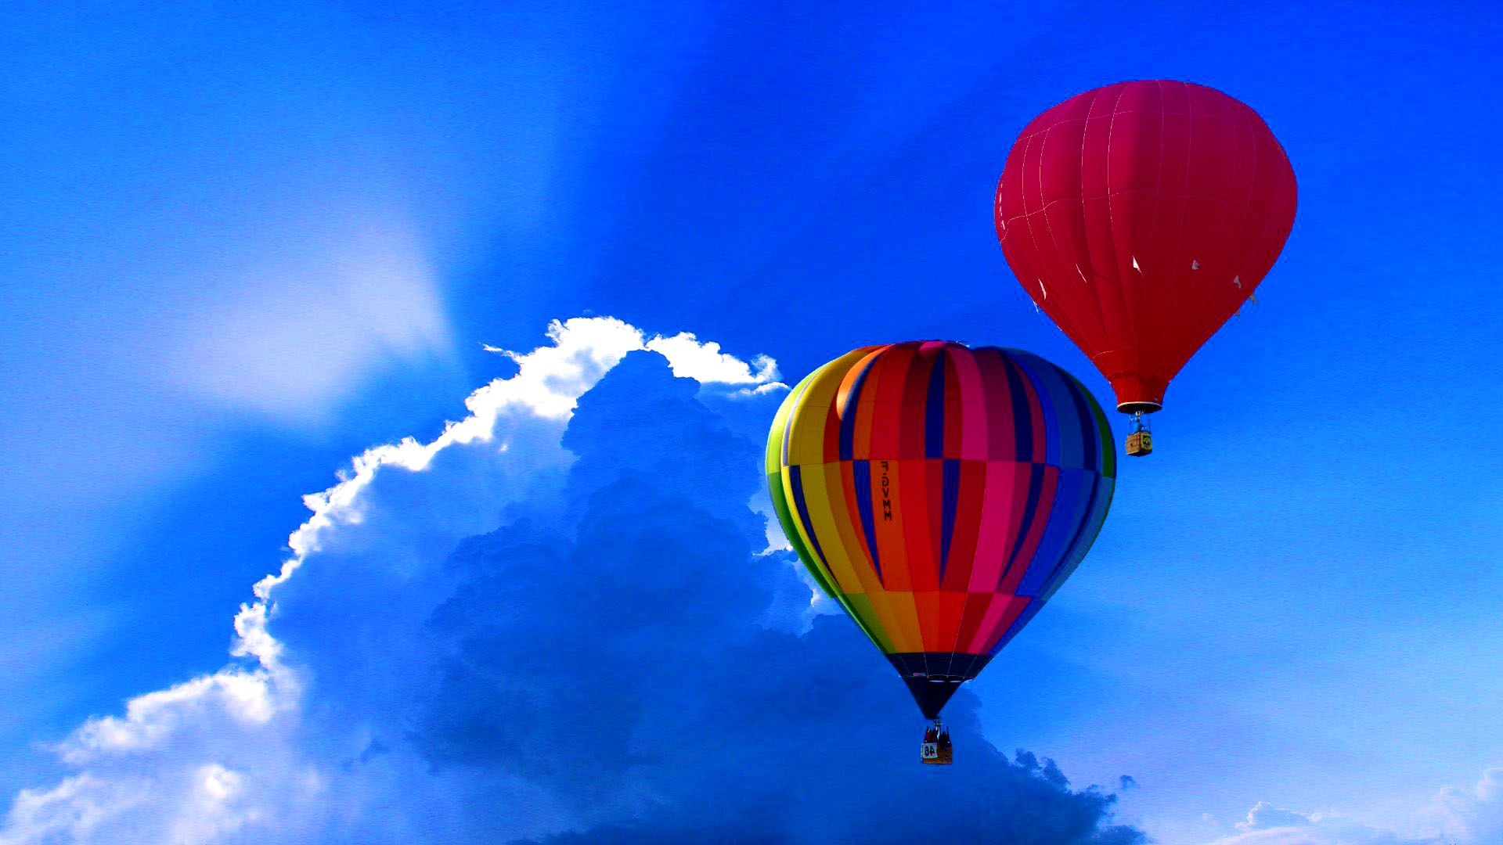
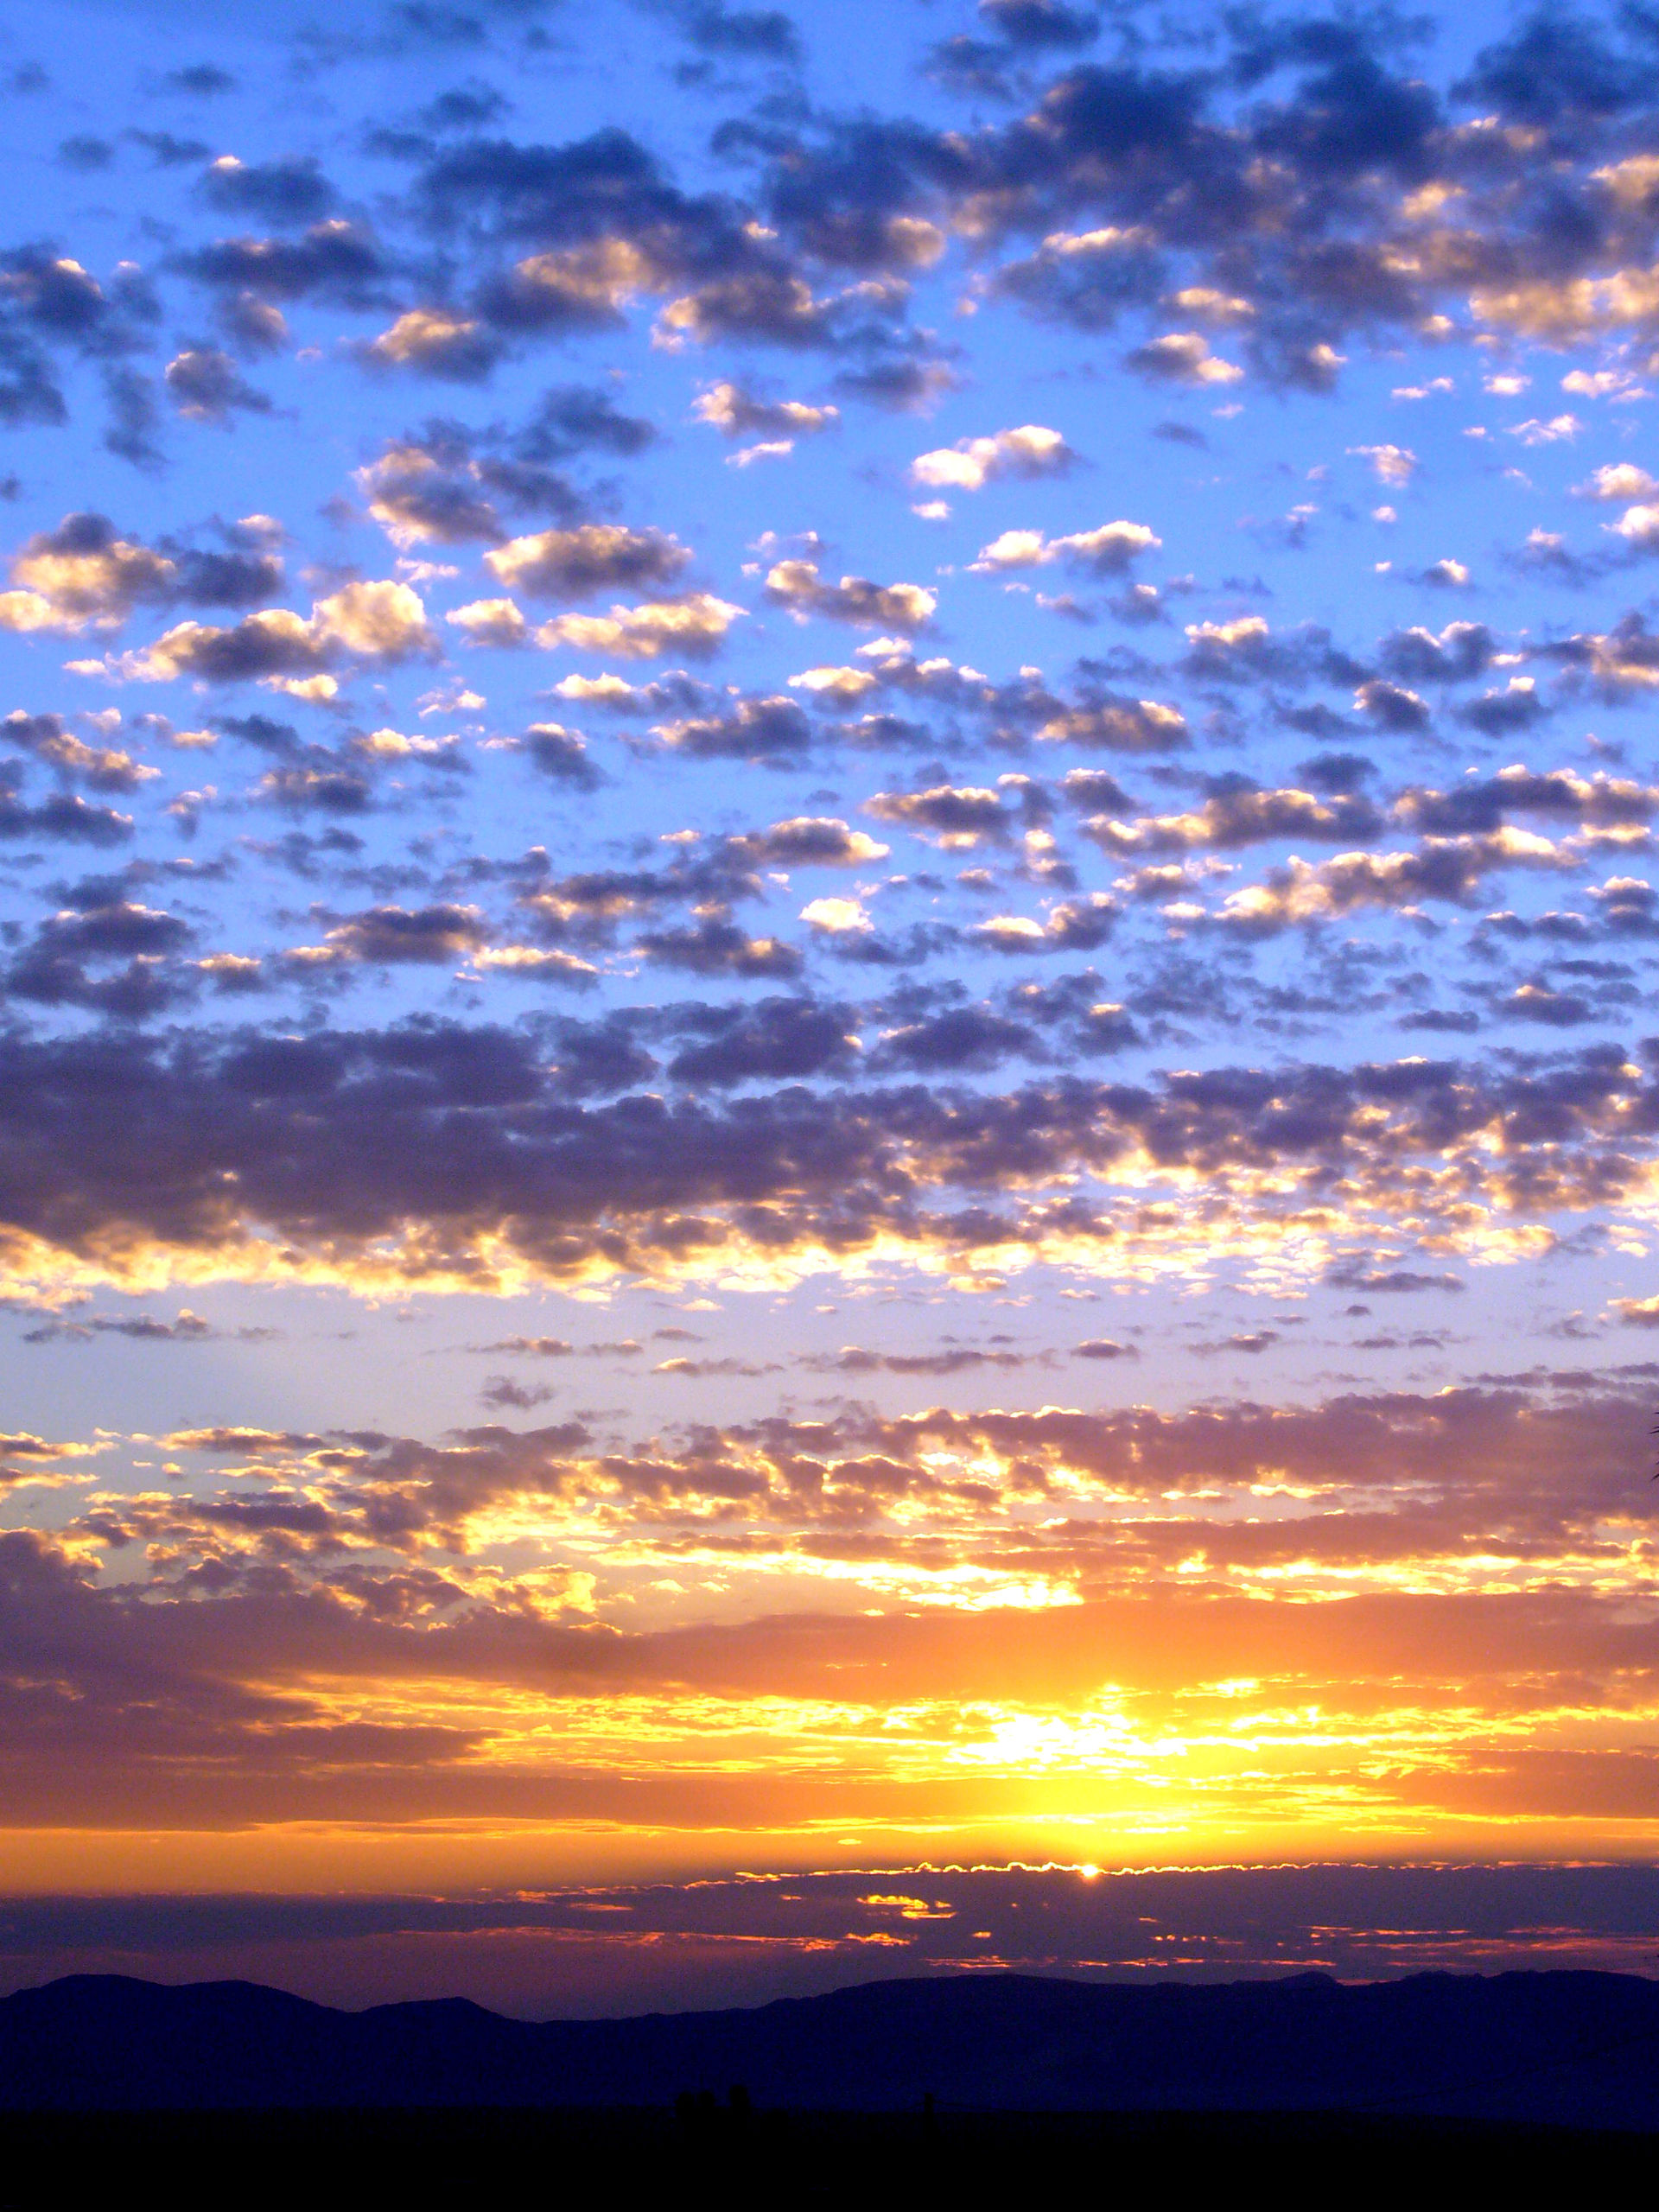
FLYING HIGH

Slide 3
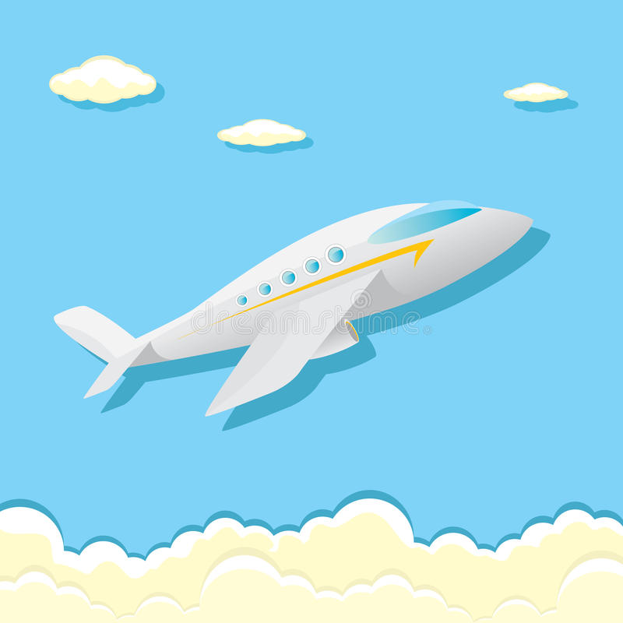
AEROPLANES
The aeroplanes can be used for many things! They can be a great way to transport from one place to another or for the military. One of the most important things inside the aeroplane is the ENGINE! Without the engine it is impossible for the plane to move forward. The wings can not lift if they are not powered by an engine.
Most aeroplanes have wings. They are used to lift the plane when they are taking off. The shape of the wings is called an airfoil.
The cockpit is where the pilot and the co pilot sit and control the plane.

Slide 4
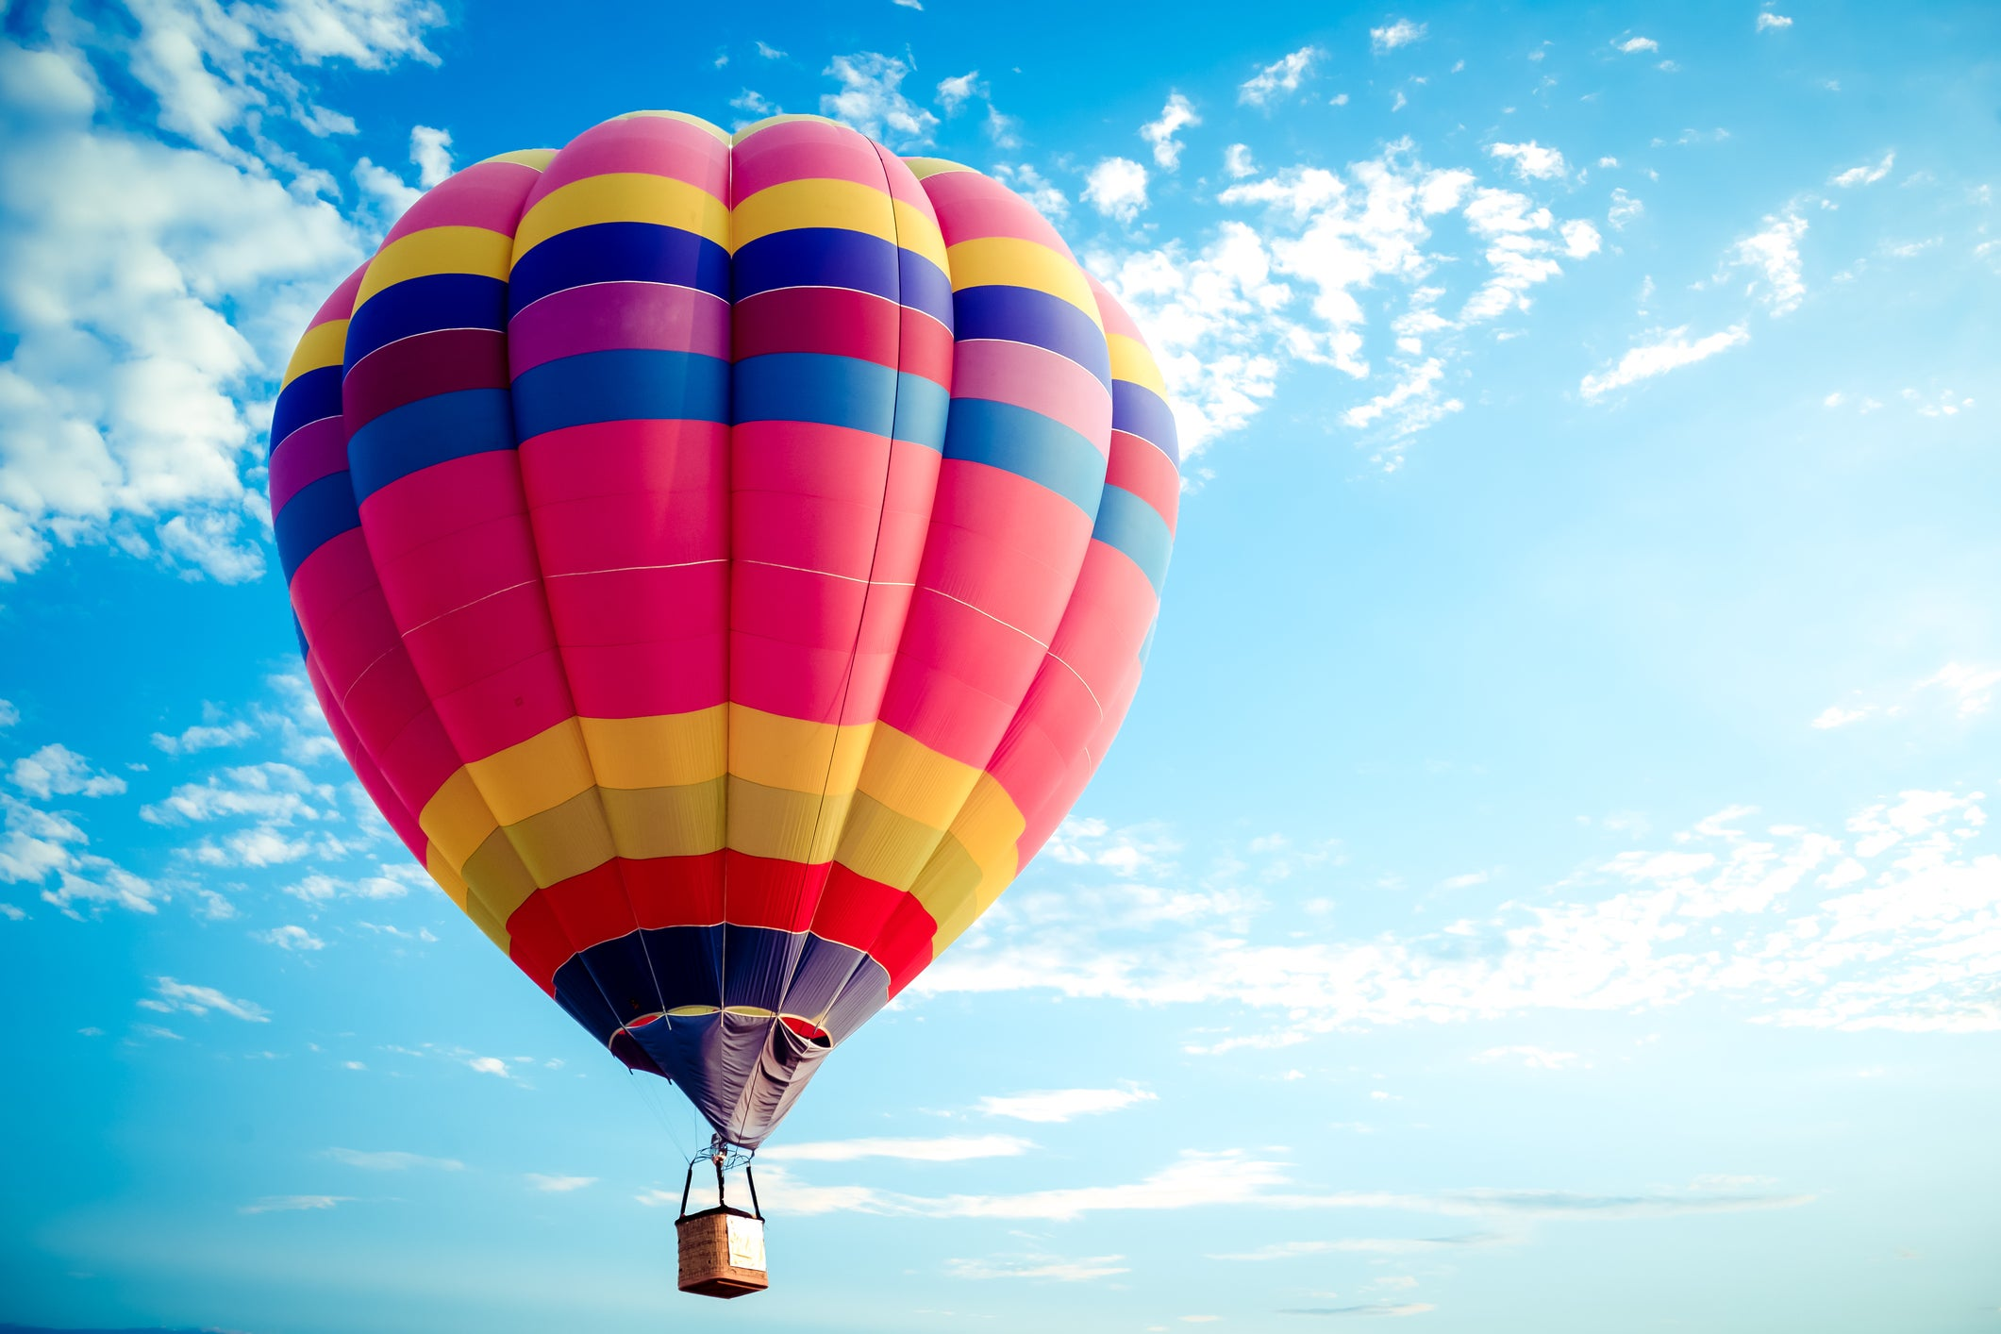
HOT AIR BALLOONS.
Hot air balloons are a great way of transport. These colourful balloons are a thrilling way to get a ‘’birds-eye-view’’ of the places around you.
The year was 1782, when Joseph Montgolfier discovered that by holding his shirt above hot air (it was a chimney fire) that it would float. This got both him and his brother thinking. They finally came up with an idea and made a material globe-shaped object. It was only one meter squared, but it managed to float up into the air to about 30 meters!

Slide 5
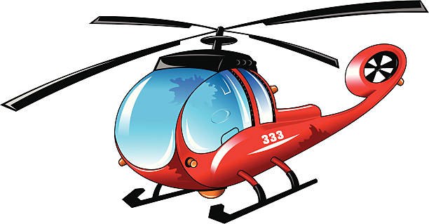
HELICOPTER
These powerful flying vehicles are also called, choppers, whirly birds and helos.
A helicopter is a type of aeroplane
known as a vertical takeoff and landing craft (VTOL). It can have a long body or it can be short and compact. The helicopter does not have wings like an airplane. Instead it has long blades or rotors. These are attached to a shaft in the engine. It also has a tail on it with smaller rotors. The pilot uses a foot pedal and two specialized pitch sticks to control the helicopters direction.

Slide 6
Thank you for viewing my PowerPoint!
-Mishal year1

