Slide 1
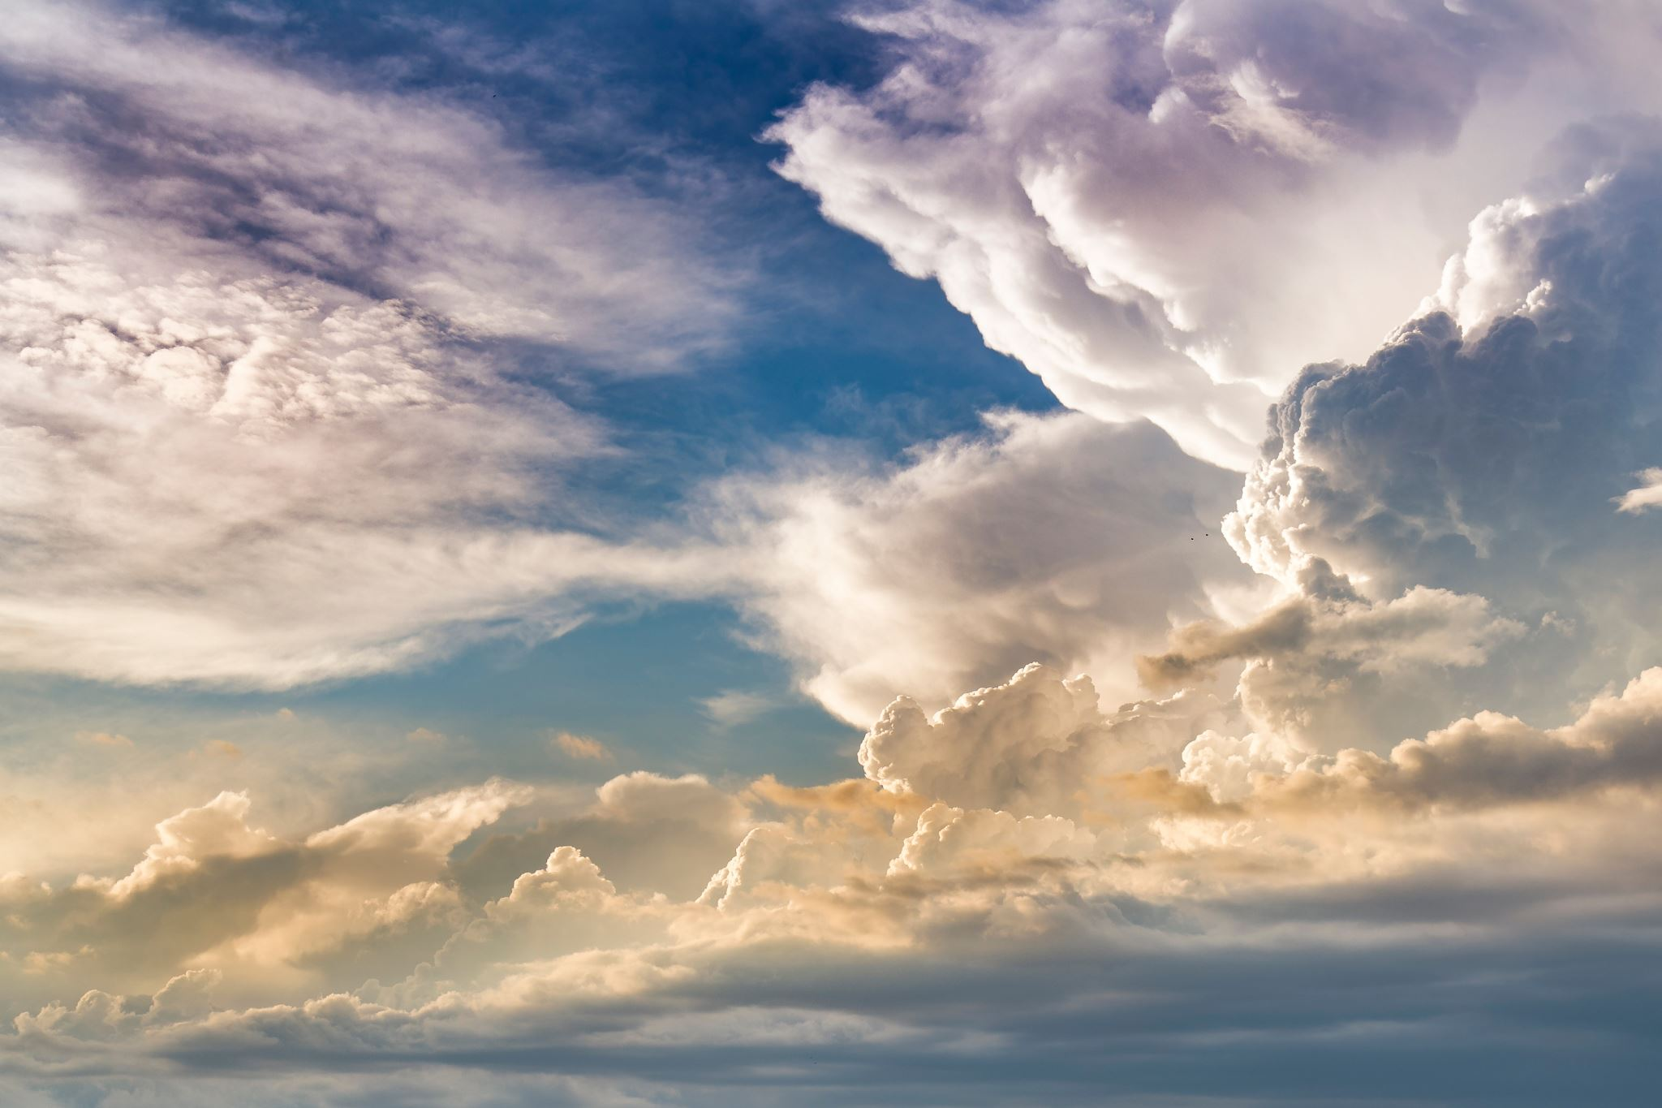
Hello, this is a slideshow so click the slideshow button and cool transitions should come up. Make sure to press the space button to go on the next slide.
Hope you enjoy!!☺

Slide 2

Hello, I am the Sun and today we are going to show you all the weathers. First we are going to introduce me the sun.

Slide 3

The Sun
The Sun is 109 times wider than the Earth and 330,000 times as massive.
Age=4.6 billion years old
The Sun is a star found at the center of the solar system.
The Sun is all the colors mixed.
Around 74% of the Sun’s mass is made of hydrogen.
Its makes up around 99.6% of the solar systems mass.
Over one million Earth’s could fit inside the Sun.
The Sun’s surface temperature is around 5500 degrees Celsius.
The Sun is travelling at 220km per second.

Slide 4

Oh its you again, now we are going to be introducing another weather. Please give a big welcome to the rain.

Slide 5

Rain is liquid water that falls from a cloud in from of droplets.
Rain
Water can also fall from the sky in the from of hail, sleet or snow.
Rain allows to create electricity through hydropower.
Plants need water to survive, they receive much of this water from rain.
Forests that experience high levels of rainfall are called rainforest.
Heavy rain can cause flooding.

Slide 6

So now that me and Rain have introduced ourselves we are going to introduce our last guest. Which is…..Thunder.

Slide 7

Thunder is the sound caused by lightning.
The average temperature of lightning is around 20,000 degrees (36000 Fahrenheit).
Thunder
Light travels faster than sound so we can see the lightning before we hear thunder.
Strong thunderstorms can produce strong winds, heavy rain, flooding, hailing and tornadoes.
Lightning kills around 2000 people each year.
Lightning flashes more than 3 million times a day worldwide.

Slide 8

Thank you for watching!!!!!

