Slide 1


Wales

Slide 2

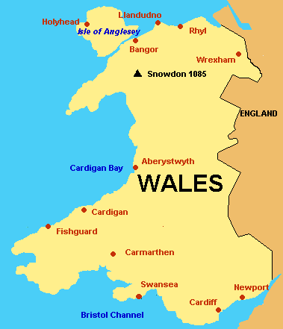
Location
Wales (Welsh] is a country that is part of the United Kingdom and is part of the island of Great Britain and offshore islands. It is bordered by England to its east, the Irish Sea to its north and west, and the Bristol Channel to its south.

Slide 3
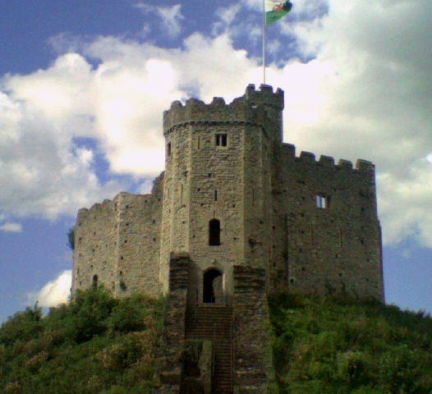
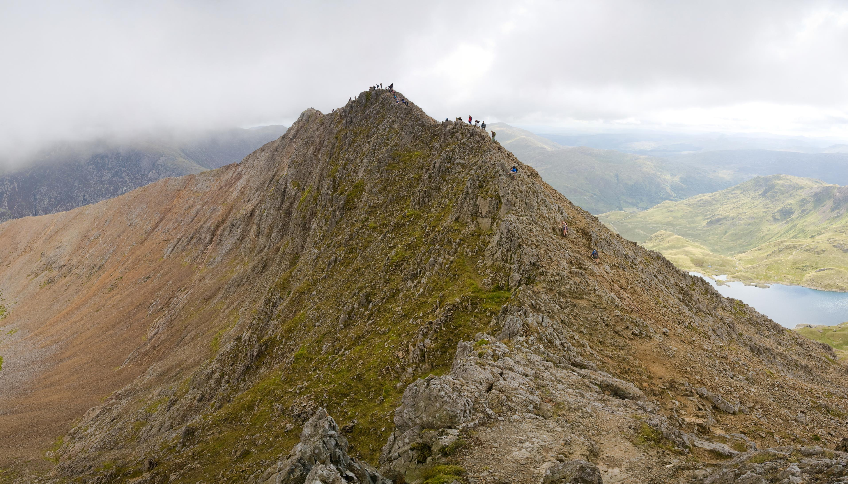
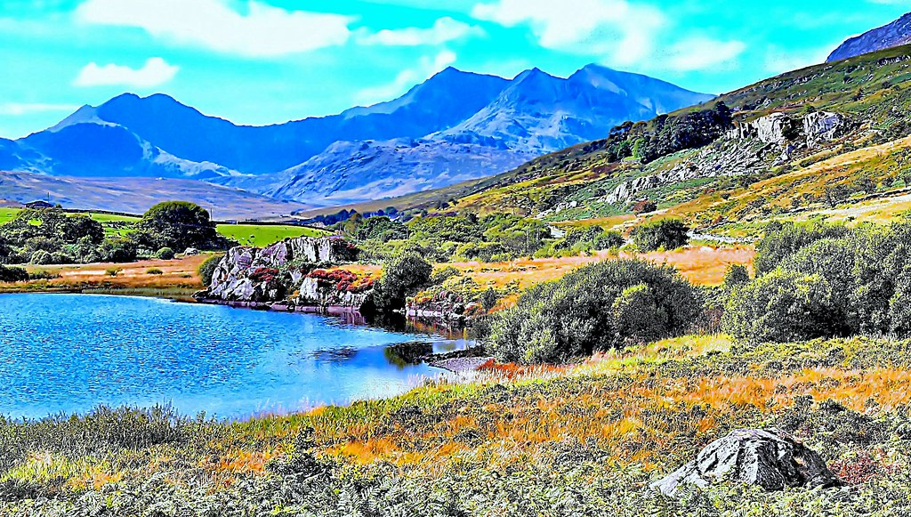
Landmarks
Snowdown
Cardiff Castle
Snowdonia Park

Slide 4
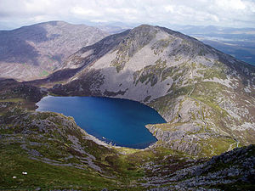
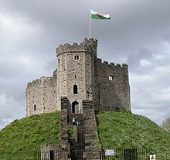
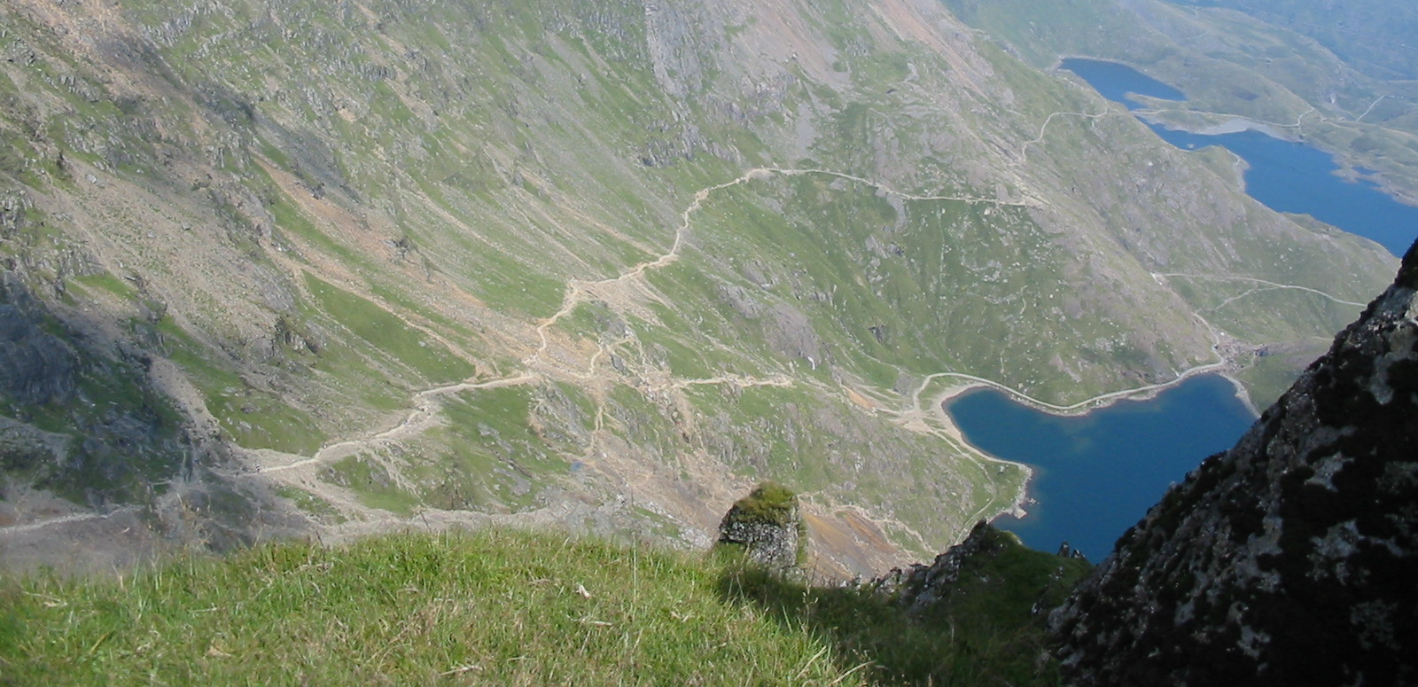
About the Landmarks
The landmarks that I talked about were the most visited ones
Where is Snowdonia National Park: Snowdonia is a region in northwest Wales located around the mountains and glacial landforms of huge Snowdonia National Park.
Where is Cardiff Castle: Cardiff Castle is mind blowing it’s located in the city centre of Cardiff, Wales.
Where is Snowdown : It is located in Snowdonia National Park

Slide 5
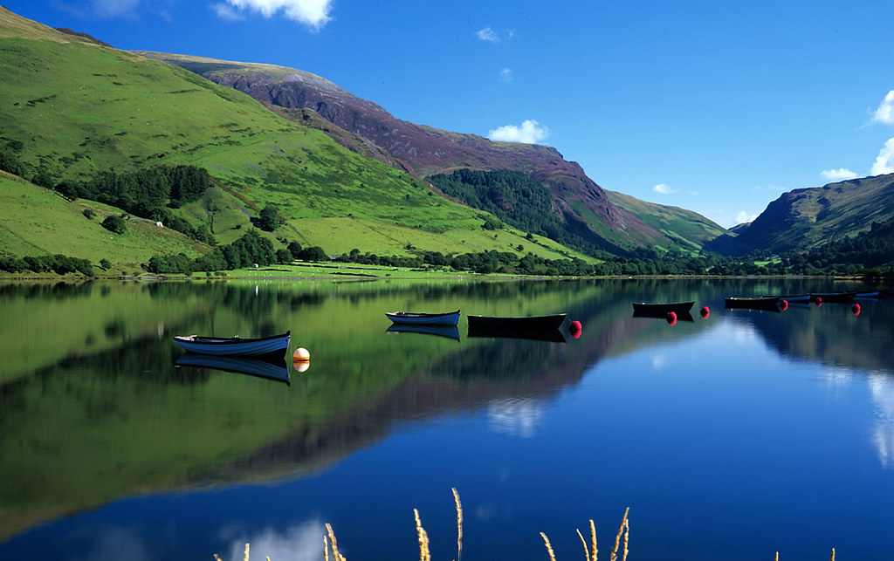

Population of wales
3.136 million
Is it possible to swim in the lake of Snowdonia National Park?
Yes, it is possible to swim in the lake

Slide 6
I hope you enjoyed!!!

