Slide 1
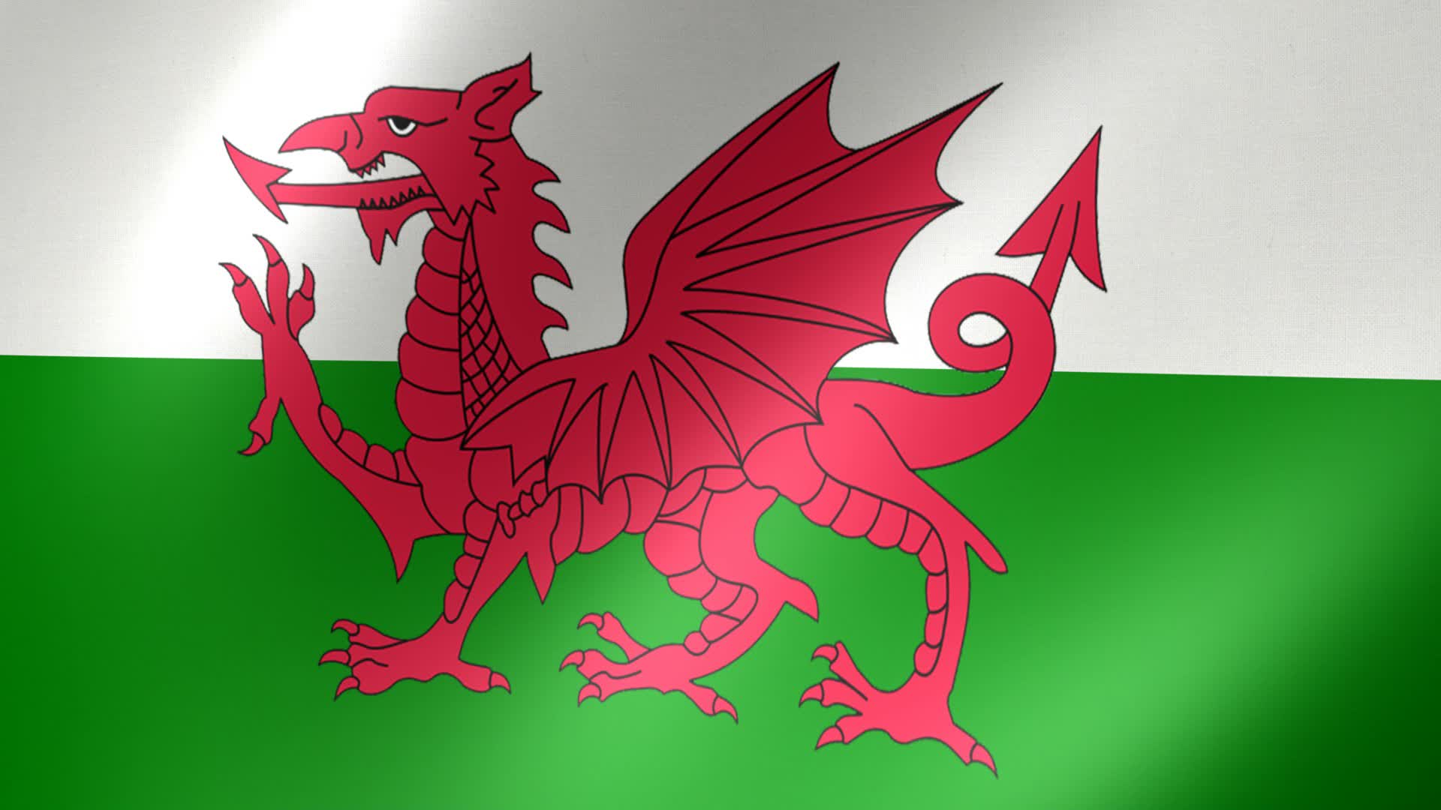
Wales
Wales (or Cymru which is in Welsh) is a country that is part of the United Kingdom and is part of the island of Great Britain and offshore islands. It is bordered by England to its east, the Irish Sea to its north and west, and the Bristol Channel to its south.

Slide 2
Facts About Wales
Population: 3.1 million people
Currency: Pound Sterling
National Day: St David’s Day, 1 March
National symbols: The dragon, daffodil and leek are three of a number of national symbols.
Llanfairpwllgwyngyllgogerychwyrndrobwllllantysiliogogogoch (llan-vire-pooll-guin-gill-go-ger-u-queern-drob-ooll-llandus-ilio-gogo-goch (Llanfair PG for short) is a small, quiet town on the island of Anglesey off the northwest coast of North Wales, famous for having the longest place name in Europe. Apart from its name it is similar to other nearby villages.

Slide 3
Who founded Wales?
At the time of the Norman conquest of England in 1066, the dominant ruler in Wales was Bleddyn ap Cynfyn, who was king of Gwynedd and Powys. The initial Norman successes were in the south, where William Fitz Osbern overran Gwent before 1070

Slide 4
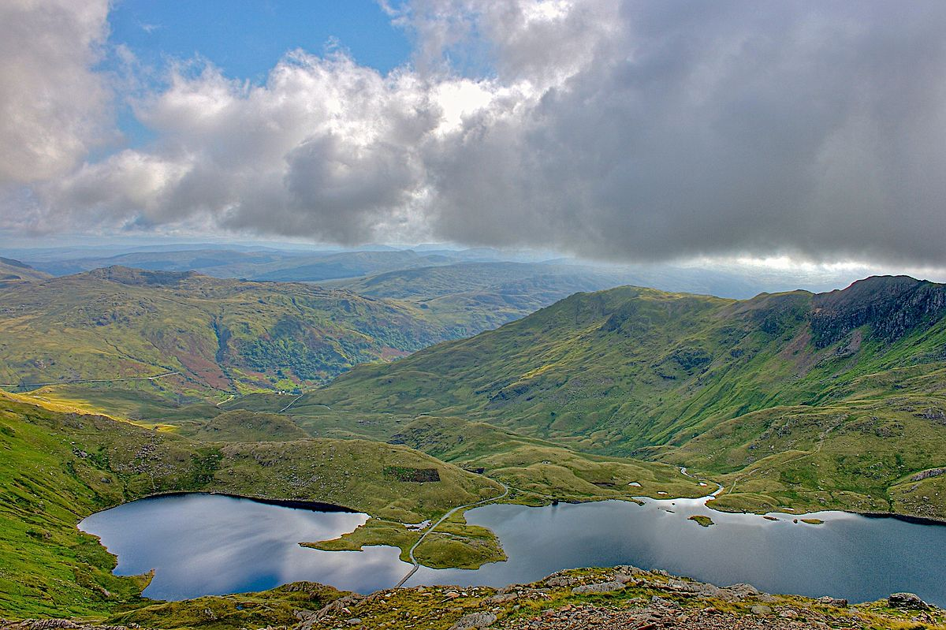
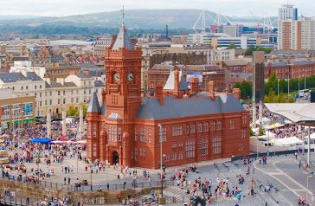
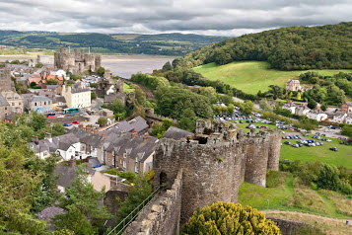
Places to visit
Conwy
Snowdonia National Park
Cardiff

Slide 5
This is the end
I hope you enjoyed my project about Wales.
Thank you for your time.

