Slide 1
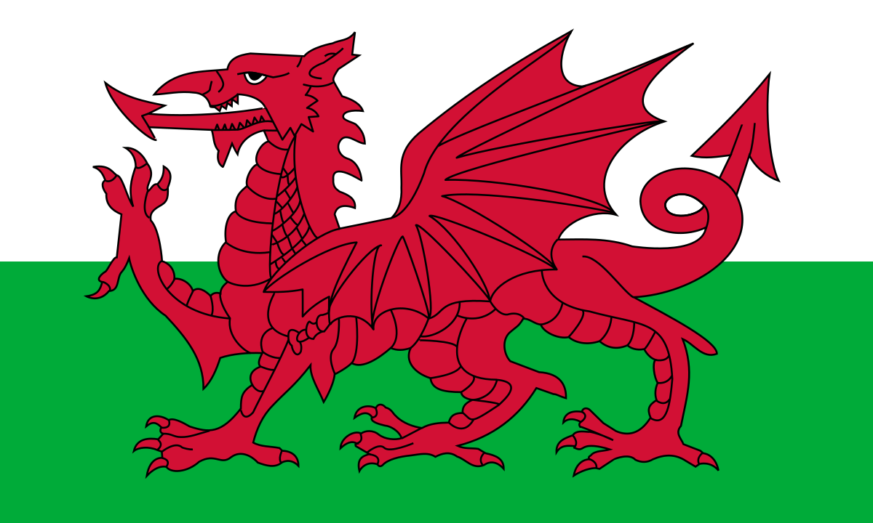
Wales

Slide 2

Wales
Wales is a southwest country of the United Kingdom, its capital is Cardiff and is also its biggest city. Their official languages are Welsh and English. The Welsh name of Wales is Cymru (which means fellow countrymen).
The population was estimated to be around 3 100 000 people in 2018.
The country is known for its coasts and its Celtic culture.
Wales is also known for its national teams in sports as football and rugby.
Wales was ruled by England from the year 1284 and officially annexed into Britain by the “ Laws in Wales Acts 1535 and 1542” or “Act of Union” Since 1301 the union was symbolised by calling the Crown Prince of England, the Prince of Wales

Slide 3

Nice places to see in the Wales

Slide 4
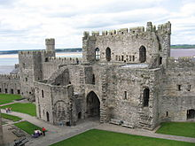
Caernarfon Castle
Despite its massive size, Caernarfon Castle was never completed. King Edward I of England had construction start on it in 1283, and massive amounts of money were spent on it until work was finished in 1330. While some parts of it were never finished, the castle served as an important military fortification up to the English Civil War.

Slide 5
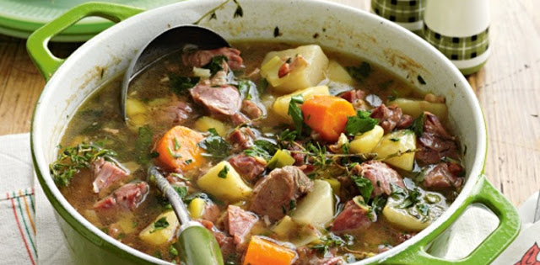
Welsh cawl
Cawl is traditionally a hearty dish made of meat and any vegetables available. There are many recipes often handed down through the family and vary from town to town throughout Wales. The dish is also known as ‘lobscows’ in areas of north Wales. It is often better the day after preparing when all the flavours have developed. It is served in some areas in a wooden bowl and eaten with a wooden spoon with chunks of homemade bread and Welsh cheese.

