Slide 1
This project is a slide show so click the slide show button and transitions should come up. Press the space bar button to go on a new slide.
Hope you like it!!!☺
Instructions

Slide 2
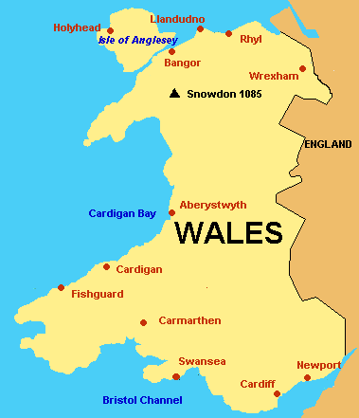

Hello, I am the King of wales and I am doing a whole presentation about……..WALES!!!!!

Slide 3

But first I am going to tell you some basic facts about Wales and then some facts that you maybe never knew!!!!☺

Slide 4

Facts!!!!:)
1.Population=3.1million/4.8% of UK
2.Location=Wales is on the Island of Great Britain to the West of England
3.Time Zone=GMT
4.Currency=Pound Sterling
5.Cities=There are currently six cities in Wales; Bangor,St Asaph,Cardiff,Newport,St Davids,Swansea
6.Highest Mountain=Snowdon with 1,085 meters
7.Biggest Natural Lake=Llyn Tegid with 5.95km in length
8.Climate=Wales weather is mild and variable with average temperature of around 20 degrees (68 degrees Fahrenheit) in summer, and 6 degrees (43 degrees Fahrenheit) in winter
9.Capital City= Cardiff
10.Wales is one of the countries that is part of the UK as well as England,Scotland and Ireland
11.Language=Welsh+English

Slide 5

History about the Welsh flag
It was used by Henry VII at the battle of Bosworth in 1485, after which it was carried in state to St Paul’s Cathedral.
The flag incorporates the
red of Cadwaladr, King
Of Gwynedd, along with the Tudor colors of green
and white.
It was officially recognized as the Welsh national flag 1959.

Slide 6

Wales is called Cymru in Welsh
Cardiff’s Millennium stadium has the largest retractable roof of any sports stadium in the world.
Fun Facts!!!!!!
42% of the South and West Wales coastline is designated as ‘Heritage coast’
Wales was ruled by England from the year 1284 and officially incorporated into England by the ’Laws in Wales Acts 1535 and 1542’ or ‘Act of union’. To symbolize this unification of the two countries since 1301, the crawn Prince of England has been referred to as the prince of Wales.

Slide 7

Thank you for watching

