Slide 1
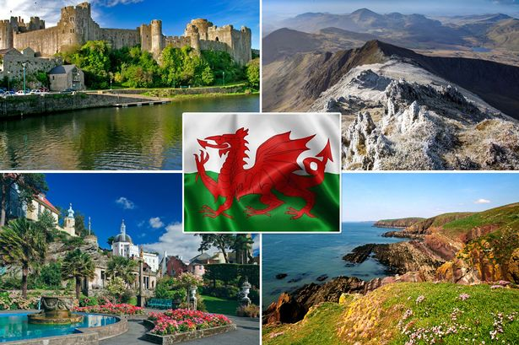
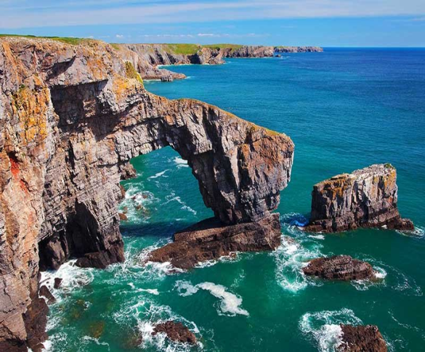


Wales
Population: 3.1 million people. 4.8% of the UK population.
Location: Wales is on the island of Great Britain, to the west of England.
Size: Wales is roughly 20,800 square km in area.
Time Zone: GMT
The country of Wales is one of the four parts of the United Kingdom along with England, Scotland and Northern Ireland.
Cardiff is the largest city and also the capital of Wales.
Prince Charles is the current Prince of Wales. The country of Wales contains more castles per square mile than any other country in the world.
The Welsh national game is rugby and the welsh language is (Cymraeg) is the oldest language in Britain.
The climate is mild and damp, it rains a lot in wales.

