Slide 1
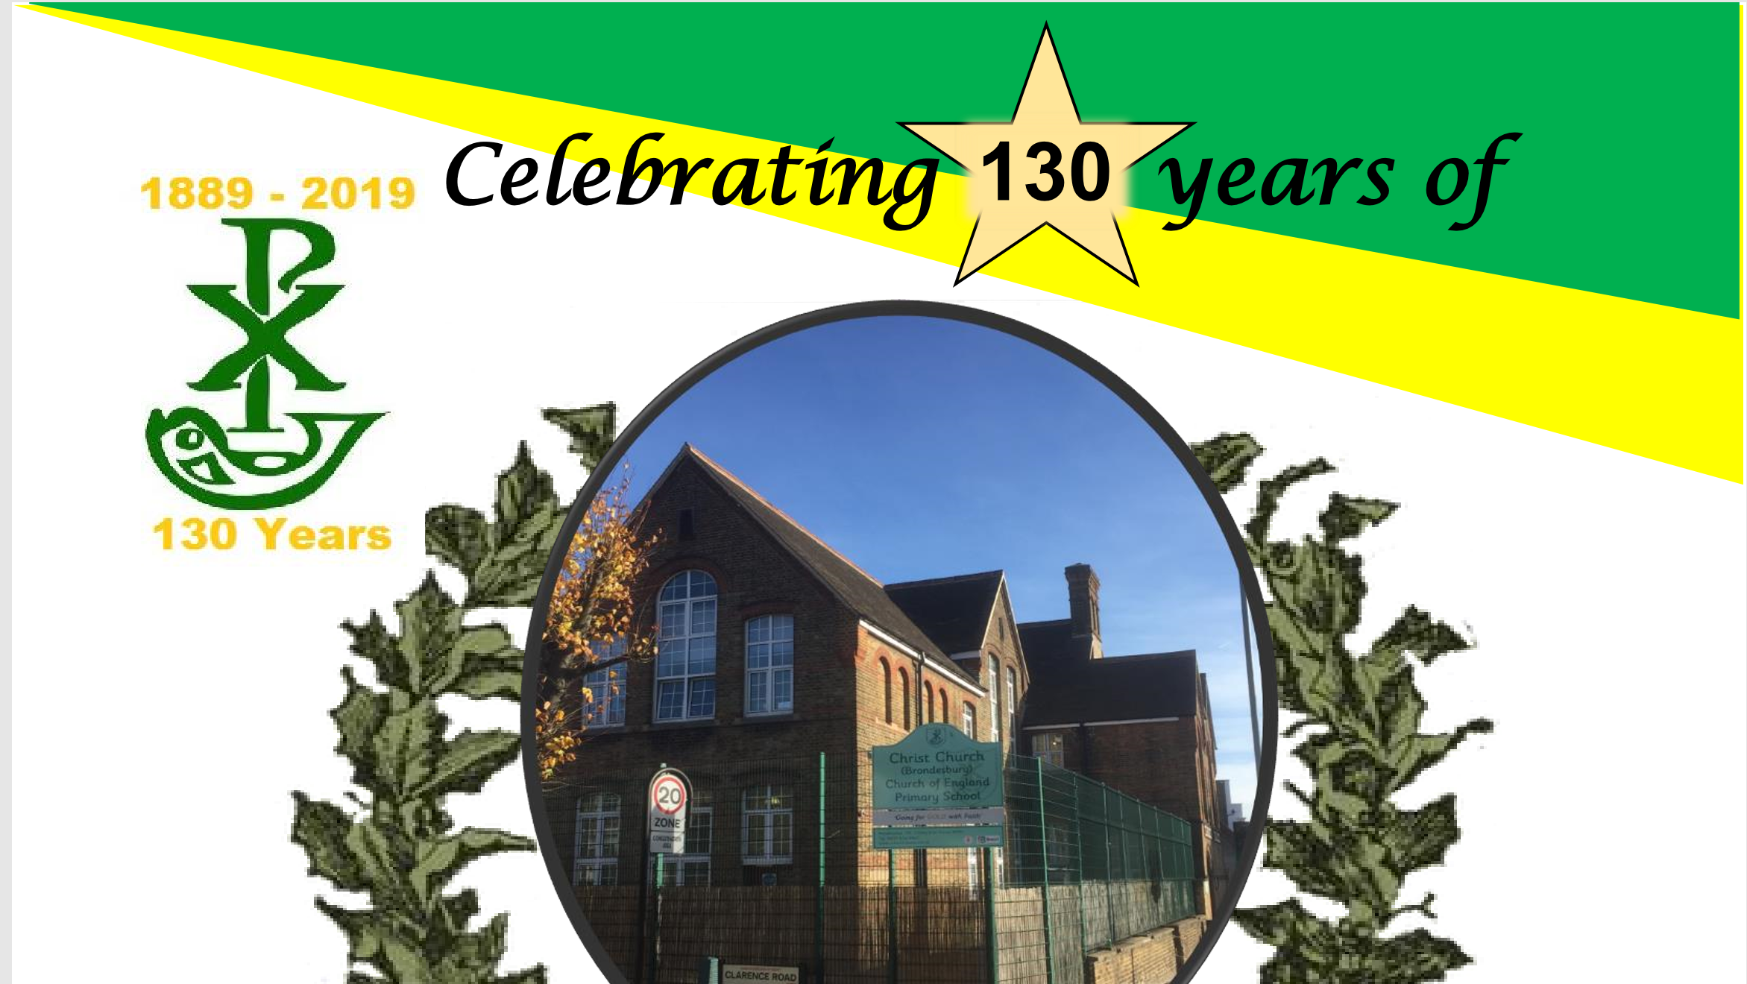
Christ Church Brondesbury Primary School
Notes:
Welcome to our celebration of Christ Church School.
Sit back, relax and we shall inform you of the history of education here at Christ Church.

Slide 2
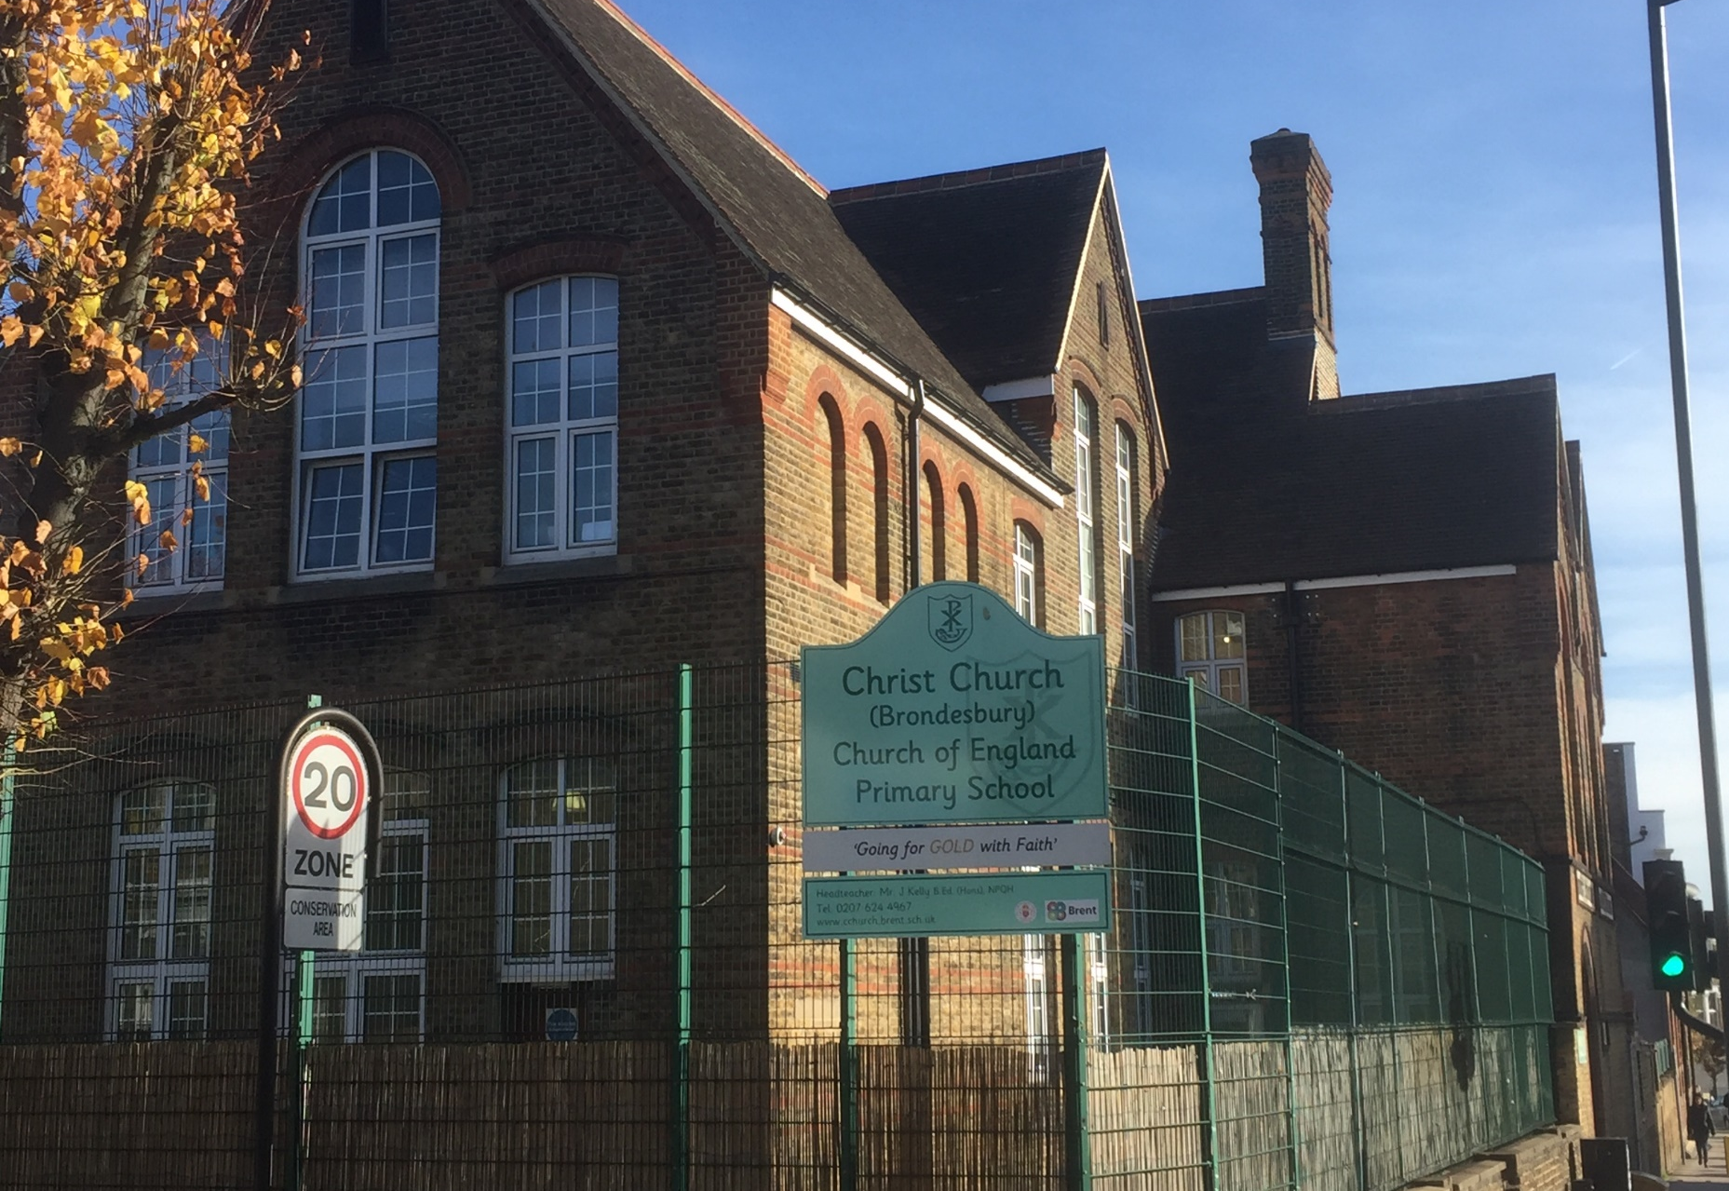

Our school was opened in 1889
Notes:
Our school was opened in 1889 – as it says on the slide.
Of course, that makes us 130 years old this year.
So, let’s find out a bit about what education was like 130 years ago… first – a bit of history.

Slide 3
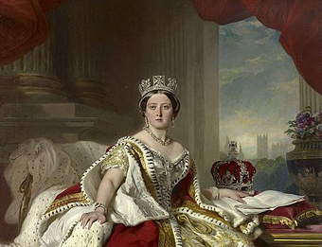
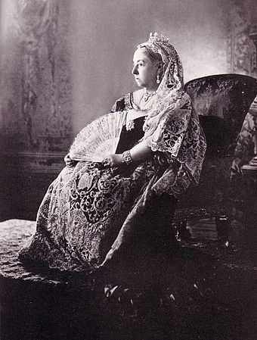
In 1889 Queen Victoria was on the throne
Queen Victoria reigned from 1837 to 1901 – 63 years , seven months and two days.
She lived to the ripe old age of 81 years old
Notes:
As it says, Queen Vitcotria was the reigning monarch in 1889, when our school was opened.
Queen Victoria was on the throne from 1837, when she was 18 until she died at the age of 81 in 1901.
At this point, Victoria was the longest reigning Queen Britain ever had.
However, our current Queen – Elizabeth 2nd – has now been Queen for 66 years.
She became queen at the age of 25. She is now 93 years old. In 2022, we will celebrate Queen Elizabeth’s Platinum anniversary.

Slide 4
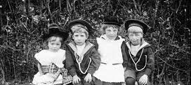
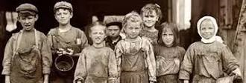
Education in early Victorian Times – until 1844
When Queen Victoria first came to the throne most children did not go to school.
Rich children were educated at home by governesses until they were ten . Then the boys were sent to Public schools like Eton, Harrow or Rugby. The girls were taught at home .
Poor children were sent to work in the factories and most could not read or write.
Notes:
At the beginning of Victoria’s reign, there were no schools like we had today. Most children didn’t go to school at all!
If you were poor, then you went to work in a factory, or to do physical jobs like cleaning chimneys, or selling things at markets.
The rich children had a different life. Until they were 10, they were taught at home by someone called a Governess, which is like a private tutor.
After 10 years old, boys were sent to public schools and the girls continued to be taught at home.

Slide 5
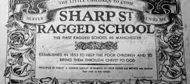
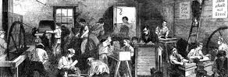
How education changed in Queen Victoria’s reign
The Victorians realised the importance of education.
They wanted all children to learn to read and write
In 1844 ‘Ragged Schools’ were set up to provide free basic education for poor children.
Notes:
Unfortunately for us children, The Victorians realised that education was important in order to have a good life.
They had the good idea of teaching all children to read and write.
In order to do this, schools called “Ragged Schools” were set up to teach poor children basic skills. Perhaps they were called Ragged Schools because the poor children wore ragged clothes?

Slide 6
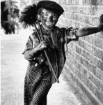
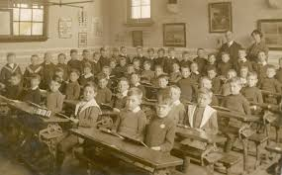
More changes
In 1870 a law was passed requiring all parts of Britain to set up schools for children between the ages of 5 and 12.
But education wasn’t compulsory and not all the schools were free, so many children carried on going to work as their families were so poor.
Notes:
As you can see here, l new law was passed in 1870 which said that all places in Britain had to start schools for children between the ages of 5 and 12.
Most of these schools were set up by Church foundations and many of them still exist today.
However, even though it was the law to build and provide schools, it still wasn’t the law that you had to attend!
Many of the schools had to be paid for and the poor families could not afford this.
Therefore, many poor children still did not go to school and continued to go to work instead.

Slide 7
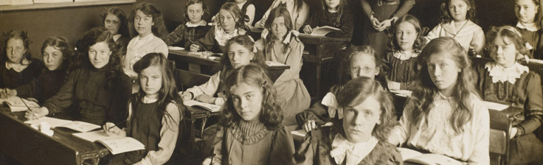
Finally in 1880…
Schooling became mandatory.
All children,boys and girls, had to go to school until the age of 12.
In 1889,the year that Christchurch opened, the school leaving age was raised from 10 to 12.
Notes:
In 1880, that all changed.
Someone somewhere had the idea to make school mandatory for all children to go to school until they were 10 years old. (Mandatory means you have to do it!)
From 1880 until 1889 – you only had to go until you were 10 years old. However, the year Christ Church opened, the leaving age was raised to 12.

Slide 8
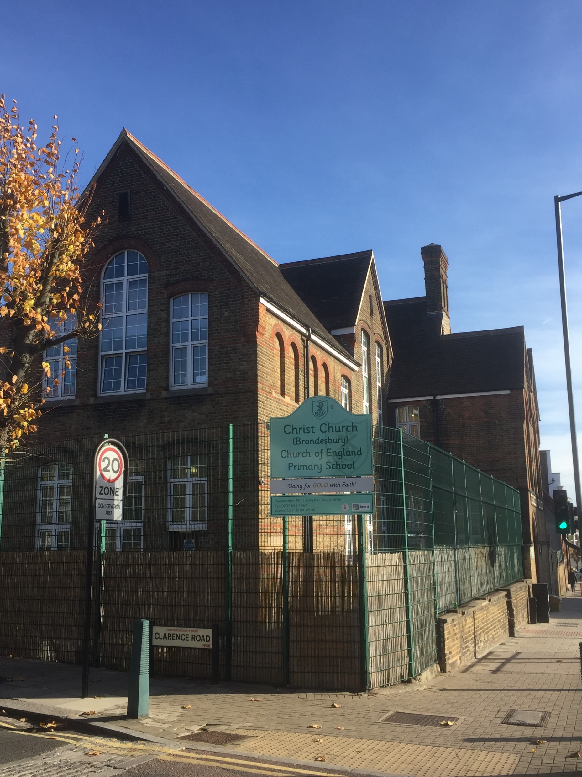
The early years of Christchurch Brondesbury
The Infants School was founded first
It was opened by Canon Gregory on 11th October 1889
The Boys’ School was opened in 1893 and the Girls’ School in the same year.
An extension was added in 1907
The boys’ and girls’ schools were separated by a locked door at the foot of the stairs !
They also had separate entrances . You can still see these today on Willesden Lane
The Junior School was not mixed until 1938 – nearly 50 years after opening.
Notes:
As you can see, the first part of the school to be opened was for the Infants. This school for little children was opened by a priest called Canon Gregory on October 11th 1889.
(Just so you know, a Canon is a priest who has been serving for a long time.)
The Boys and Girls schools were separate. They had different entrances on Willesden Lane and were separated inside by a locked door.
In 1907, the school was made bigger with an extension. We’re not sure, but we think that may be the part where the Year 6 class is above the staffroom now.
Up until 1938 boys and girls were educated separately, not like today, when we are in the same classes all the way through school.

Slide 9


The Boys’ School
The first Headmaster was Mr Charles Wreford.
He stayed for 40 years, retiring in 1932.
By 1894 there were 57 boys at the school.
By 1907 there were 115 boys
Mr Wreford was also a part time actor and encouraged the pupils to perform.
In the First World War he had leave to go to entertain the troops !
During World War 2 he had his own Radio Show.
Notes:
The Boys’ School was first run by someone who was a bit of a legend…
Mr Charles Wreford was Headmaster for 40 years between 1893 and 1932.
Just imagine – in his first couple of years, there were 57 boys here at school. This number grew and grew until there were 115.
Since Mr Wreford was an actor, he had to leave school during World War 1 (which was between 1914 and 1918) in order to go and entertain the troops. Then during World War 2 (from 1939 – 1945) Mr Wreford entertained the nation with his own radio show.
Imagine – back then they had an acting, radio-presenting superstar running the school. Now… we’re stuck with Mr Kelly and his guitar…

Slide 10
The Girls’ School
The school opened in 1893 with 58 pupils
By 1894 there were 82 pupils on roll
Miss Louise Banting was the first Mistress.
There was one other assistant.
Only unmarried women were allowed to teach at the school.
Notes:
The girls’ school opened in the same year as the boys’ school.
In the first year there were 58 pupils, but in the second year, there were 82… that’s more than in the boys’ school at the time!
In order to teach the girls, the Headmistress Miss Banting was helped by only 1 other teacher.
(The lady teachers all had to be unmarried… so… sorry Mrs Jude, Mrs Hardy, Mrs Roy, Mrs Patel… you’d all be out of a job!)
To put this into perspective… in 1894 there were 82 girls and 57 boys… that’s 139 children altogether with 4 staff.
This year we have 190 children, with almost 30 staff in school!

Slide 11
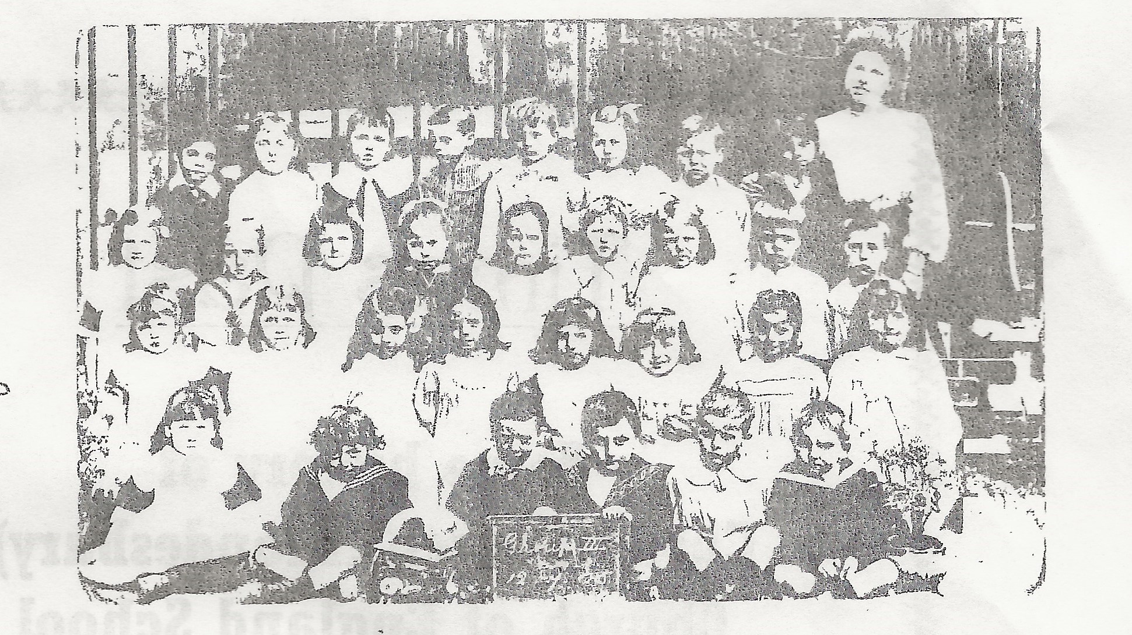
Christchurch Children : 1906
Notes:
Here you can see some of Christ Church School’s children from 1906…
If you look closely – you will see that the girls are all wearing a white frock over their clothes
and the boys… well – don’t they all look fabulous in their little sailor outfits???

Slide 12
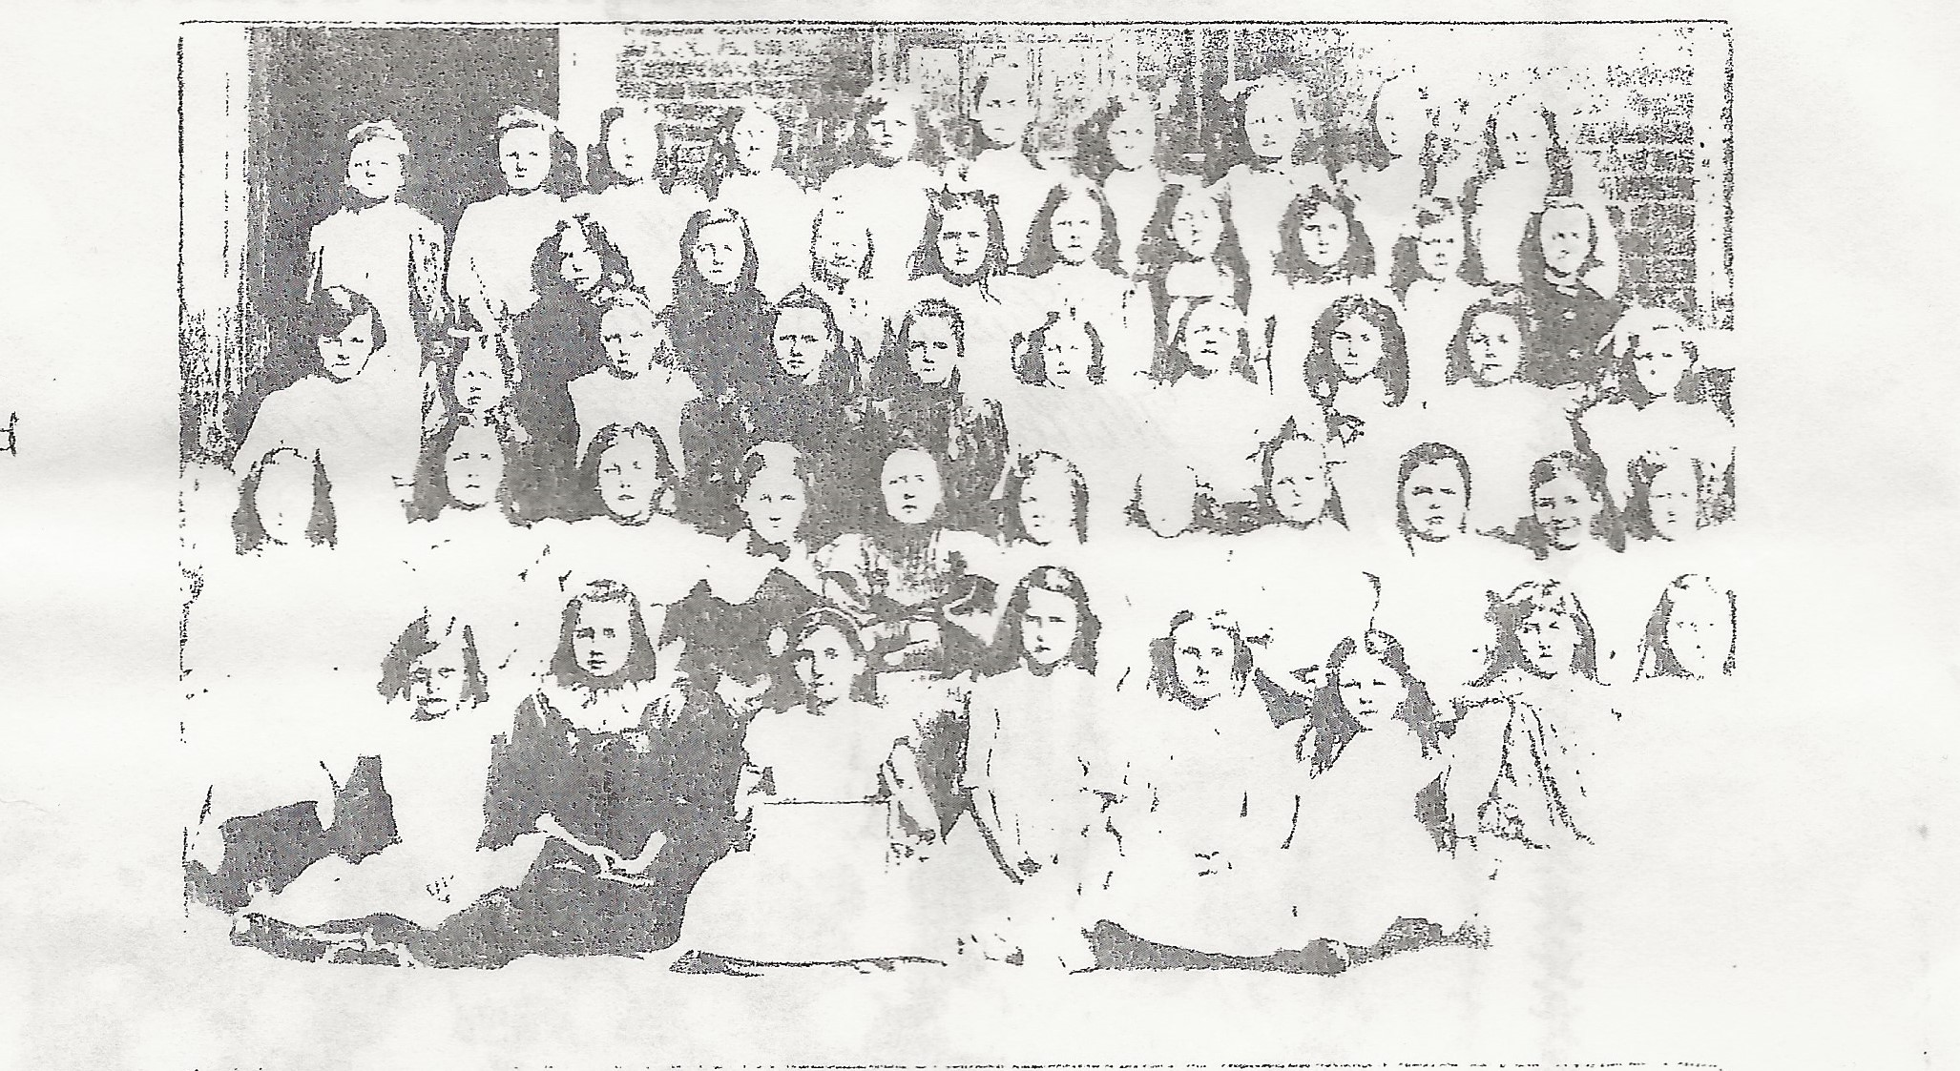
Undated photo : Christchurch girls
Notes:
Here are some more of our girls, still wearing their white frocks to cover their dresses.
This was the normal uniform in schools at this time.

Slide 13
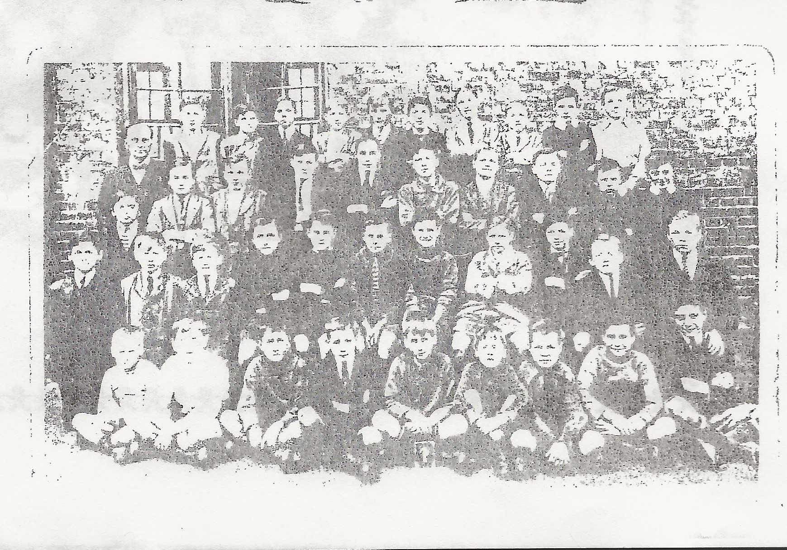

Undated Photo: Christchurch boys
Note that by now the boys are wearing a uniform
Notes:
In this photo, the boys are now wearing shirts & ties.
This shows us that the photo was taken after 1906, when the boys’ uniform changed to make them look more like young men.

Slide 14
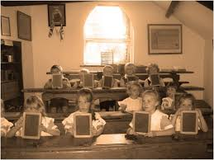
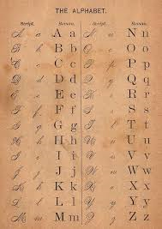
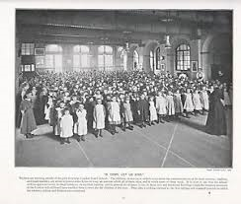
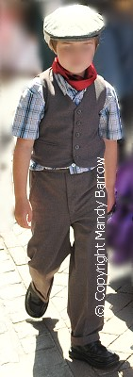
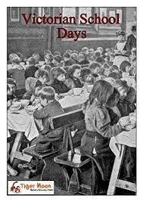
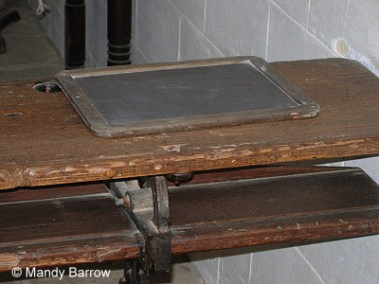
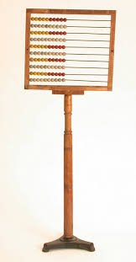
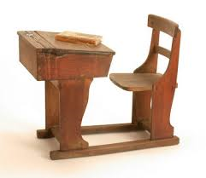
What Was School Life Like in Victorian Times?
How many different things can you spot ?
Notes:
If you look closely here, you will see how life was in a Victorian school:
Children sat in rows – not just when they were naughty, but all of the time.
Each child had their own individual desk to which the seat was attached. The desk had a lid which opened up and you kept your writing things inside.
Children did not often write on paper – usually they used chalk and slates, just the same as we use whiteboards & pens.
Writing had to be neat and was often taught joined up in “copper-plate” handwriting.

Slide 15
Life at Christchurch in the early days.
Attendance was really important. Mr Wreford kept a log book.
There was an Attendance Inspector from Willesden who inspired fear and awe in pupils and teachers alike!
94.7% attendance was seen as poor.
The school sometimes had to be closed in bad weather.
The school building was often cold and very,very draughty.
In 1894 it was so cold that the ink froze in the ink wells !
Classrooms were heated by coal fires which tended to smoke
Notes:
In Victorian times, If you did not attend school, you were visited by the Attendance Inspector. He not only told off the children and families who did not attend, he also told the school off!
Just like today the school had attendance targets… I think 94.7% would still be seen as poor attendance.
Remember 2 years ago, when we had to close the school because of the snow called “The Beast from the East?” Well, it was the same in Victorian times.
The heating systems were not as good as ours – so when it got very cold, then the school had to be closed and children could stay warm & dry at home.
I’m not sure I’d like to be taught in a class with a coal fire… not with all that smoke and the open flames. Not too good for our health.

Slide 16

Coughs and Sneezes spread diseases !
Poorer children often got sick with infections . Why do you think this was ?
Children who caught nasty infectious diseases like measles,chicken pox ,scarlet fever and diphtheria had to spend 6 weeks in an isolation hospital.
Children were excluded if their heads,hands or faces were dirty.
Notes:
Back in the Victorian days, because people’s living conditions were not as clean, dry and healthy as ours are, children often got sick.
As with today, children caught all sorts of diseases. We still get measles and chicken pox, but thankfully diphtheria seems to have disappeared. I don’t really know what diphtheria is… but it certainly sounds nasty.
When children were too ill, often they had to go to hospital to be isolated from others, in case they spread the illness.
Nowadays, we just take medicines and have less time off.
Imagine… children were also sent home if they had dirty hands & faces… how would they ever survive being in Reception class now?

Slide 17
What did the pupils learn at Christchurch?
Reading
Writing
Spelling
Arithmetic
Religious Education and Catechism
Recitation – learning long poems by heart
The boys learnt science ,drawing and Swedish drill
The girls learnt needlework,domestic science and laundry
Notes:
Here you can see a list of subjects which children were taught in Victorian schools.
We still have many of the same subjects today, such as reading, writing, spelling and arithmetic. Thankfully, we don’t often have to learn to recite long poems off by heart anymore!
We also still study RE, but nowadays we learn about religions from all around the world and we learn to reflect on how these religions are similar and different to our own.
You can see the difference between what boys and girls were taught. Boys were taught practical technical skills and something called “Swedish Drill”. This was a type of gymnastics and stretching to keep up what the Victorians referred to as “Healthy mind and healthy body”
Girls on the other hand learned skills which were practical for the home, such as needlework (that’s sewing, just in case you don’t know), domestic science (cooking) and laundry (which means washing the clothes).

Slide 18

Rewards
Prizegiving was a regular feature of school life
Prizegiving ceremonies were held in Mapesbury Hall
There were prizes for pupils with very good attendance and achievement .
High attendance was rewarded with a half day holiday.
Notes:
Just like today, children were awarded prizes at school.
However, instead of having prizegiving at school like we have, the children went to Mapesbury Hall, which was just further along Willesden Lane, somewhere near the church.
Just as we do, children were given prizes for attendance and for good achievement. But in those days, they were not Going for GOLD with faith.
Those children who had very good attendance where given a half-day holiday…
Wait… wouldn’t that reduce their attendance?

Slide 19

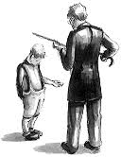
…………..and Punishments
Most of the pupils at Christchurch were well behaved .
Boys who broke the rules or played truant would be caned by the Headmaster .
We don’t know what punishments the girls received at Christchurch
In many Victorian schools children who didn’t know their letters or wrote with their left hand had to sit in the corner and wear a dunce’s hat ..
Notes:
During the Victorian times, children were punished severely for all sorts of things…
Sometimes if you wrote with your left hand, you would be caned, or have to sit on that hand… Victorians wanted everyone to write with their right hand… do we know why?
Maybe it has something to do with thinking that writing with your left hand is somehow scary, or bad… after all the Latin word for left is… sinister (which means scary or evil in modern English).
Here at Christ Church we know the boys got caned by the Headmaster (Mr Wreford) if they broke the school rules, or played truant.
What is playing truant?
Oh that’s when you deliberately don’t come to school and just go to play with your friends instead.
We can’t get away with that now… the office would just phone our mums if we were not here!

Slide 20
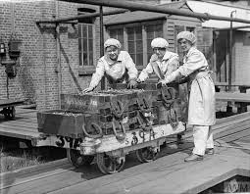
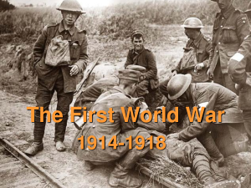
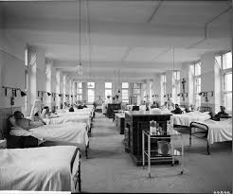
Christchurch in The First World War
Even the poor children gave money to charities to send cigarettes to the soldiers at the Front.
Lots of families moved away as they needed to work in the munitions factories.
The school roll dropped to 132
There was hardly any fuel and the school could not be heated . It was very very cold.
Pupils raised money to help the Dollis Hill Hospital where injured soldiers went to convalesce
Notes:
As we heard earlier, between 1914 and 1918, Britain was involved in the First World War. Only, they didn’t call it the First World War at the time because they didn’t think there would ever be a second one…
During this time, the school roll dropped to 132 children because many families had to move closer to factories in order to make things for the war effort.
Even though resources were used to help the army and the school was left cold and damp, children still engaged in charity work, just like we do now.
The children raised money to help those soldiers who went to war and also to help those who had been injured.
As you can see… Christ Church children have always given learning their best, owned their choices, loved themselves and their neighbours and dreamed big.
That’s why today we can still say Christ Church are always…

Slide 21

Going for GOLD with faith

Slide 22
And finally …….. A song !
https://www.youtube.com/watch?v=aXOcArf8seg

