Slide 1
Welcome to our Parent Reading Workshop@ Christ Church
Our aims for today –
Look at what the research says about reading and its importance
Understand the importance of early reading and phonics
Understand the importance of fluency and how you can build this at home
Have a clear understanding of comprehension
Give hints and tips of how to get your child reading at home

Slide 2
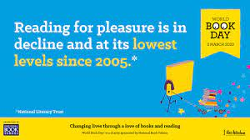
The survey of 71,400 children and young people by the National Literacy Trust early in 2023 has revealed that fewer than one in three children (28%) aged eight to 18 read daily for enjoyment. While this remains the same as for 2022, the figure stood at 38% when the survey began in 2005, marking a 26% fall in those who read daily.

Slide 3
Why is there a decline in reading for pleasure?
Games and online distractions
Rise in social media
Find books boring
Lack of time
Not being read to from an early age by adults (at home and school)
Seeing reading as a process for learning rather a pleasure activity
  ‘Reading for pleasure' is being confused with 'literacy' by many parents at home who commonly don't realise that the more it's pushed as a school subject, the less likely a child is to choose to do it. In the school environment, the national curriculum focuses on reading skills above reading pleasure. However, when pleasure drives reading, children achieve more.

Slide 4
At Christ church our children love reading but this is what some children said…
My parents don’t read with me every day because they are busy.
My mum/dad doesn’t like reading.
We don’t have time at home, so we read on the bus.
We don’t have any books at home.

Slide 5
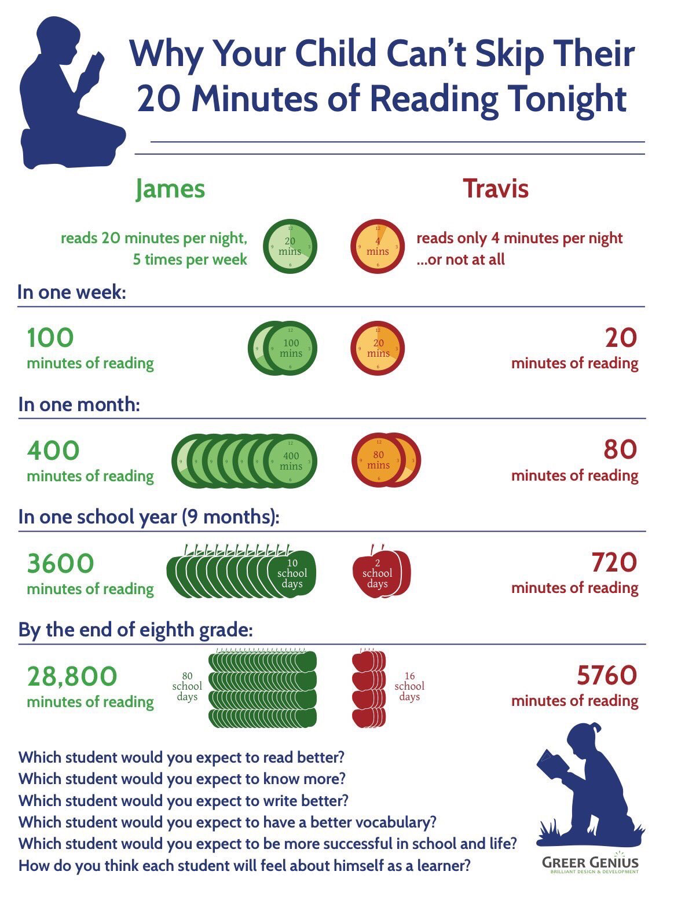
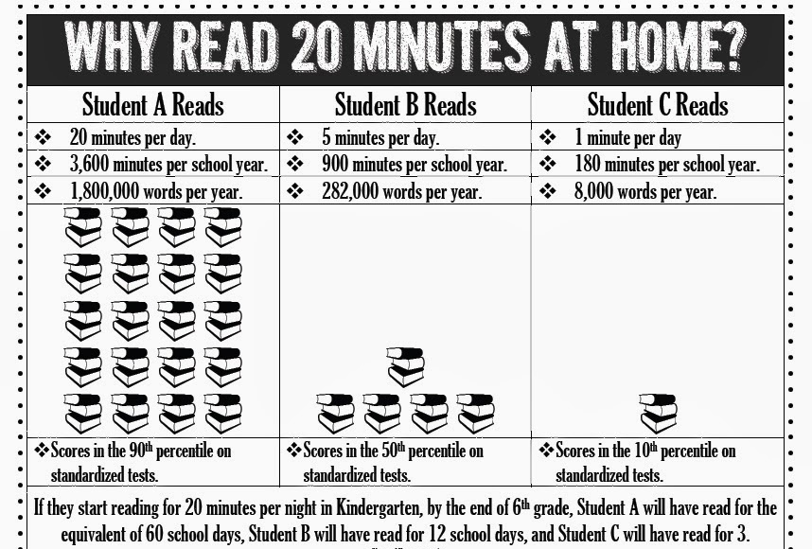
Why is reading for pleasure vital?

Slide 6
Impact of reading
Amount of reading | 20 mins | 5 mins | 1 min
Number of minutes per year | 3600 | 900 | 180
Number of words per year | 1.8 Million | 282,000 | 8000
Hours read by the end of primary school | 851 | 212 | 42
Performance on tests | 90% | 50% | 10%

Slide 7
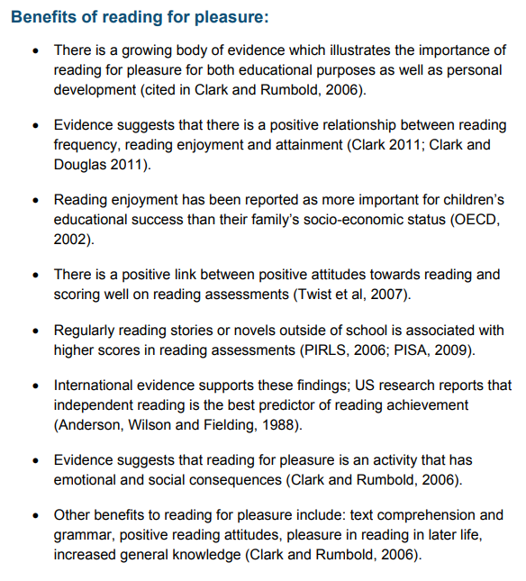
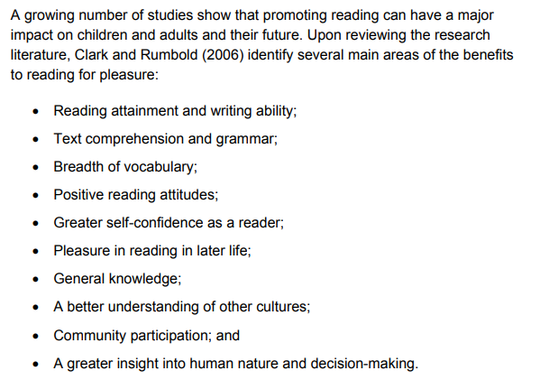




Slide 8
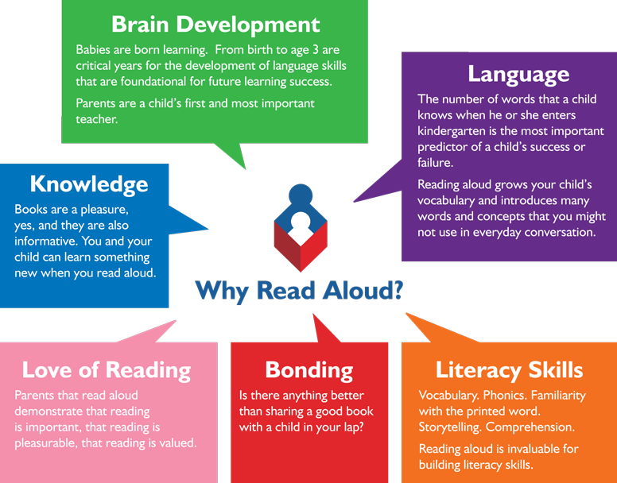


Reading from an early age and securing phonics
Reading from an early age is important as research shows that if children are not secure and fluent readers by Year 2, it is very difficult to then develop a love of reading going forward.
In order to get children fluent in reading, their phonic knowledge must be embedded within EYFS and KS1.
Read to children from day zero!

Slide 9
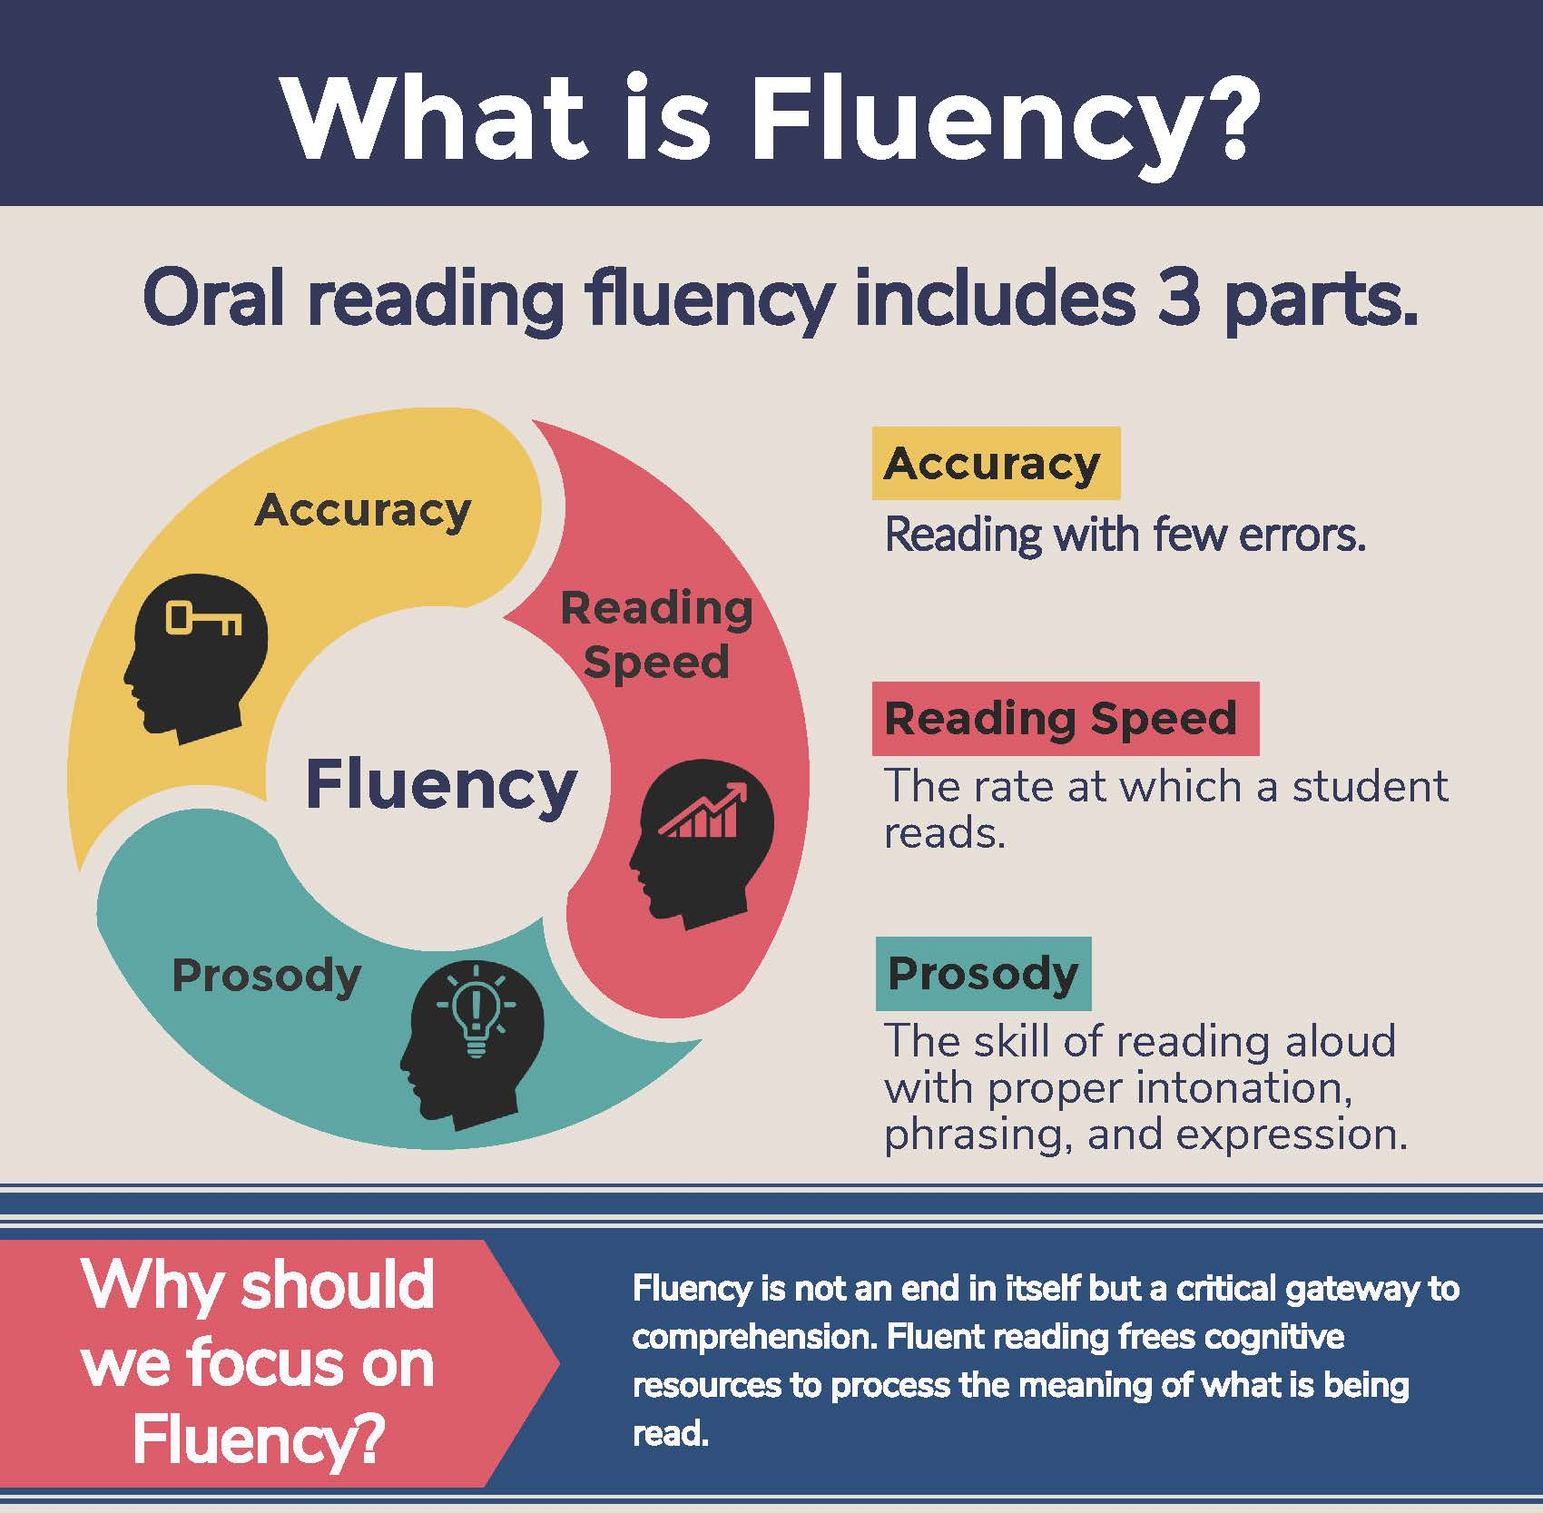
What is fluency and why is it important?
Fluent reading supports reading comprehension. When pupils read fluently, their cognitive resources can be redirected from focusing on decoding and onto comprehending the text. For this reason, fluency is sometimes described as a bridge from word recognition to comprehension.
Basically, if the brain’s processing power isn’t being used up by working out how to read a word, it can concentrate on understanding and enjoying the text.

Slide 10
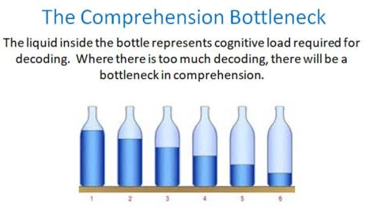
What is fluency and why is it important?
For a child to be fluent, phonic knowledge is important.
When a child is fluent, we can focus on understanding and comprehension.
When comprehension is secure, the child will enjoy what they read.
Secure phonics and fluency all reduce cognitive load.

Slide 11
Three ways you can help build fluency at home…
Read and follow – the adult reads the text and the child follows along with their finger. This helps the child with word recognition and models to them how they should read with fluency.
My turn, your turn – take turns reading a page or a paragraph. Here you are modelling how to read with fluency, flow and expression.
Echo Reading – as you read, the child copies. It is important here to pace yourself and read at a rate that your child can keep up with.
Let’s have a go!

Slide 12
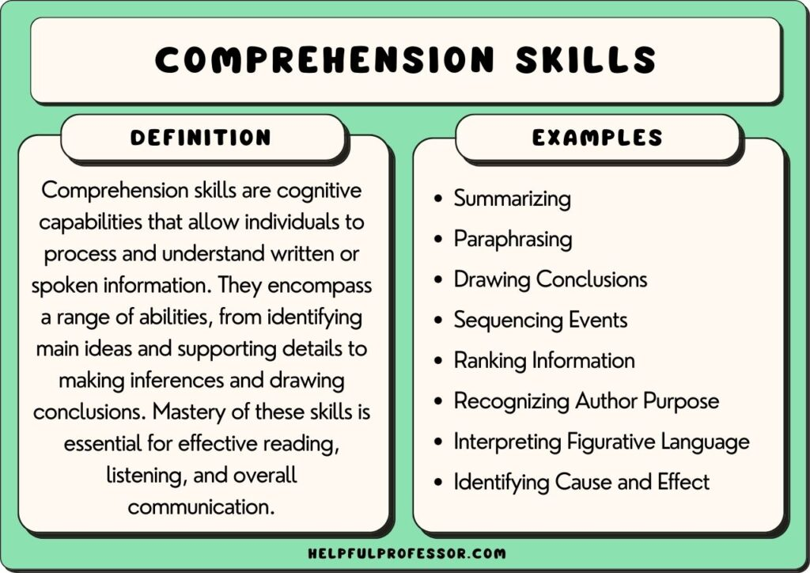
What is comprehension?
This refers to the understanding of a text.
There are cases of where children are able to read thanks to secure phonics knowledge and the ability to decode but do not understand what they have read.

Slide 13
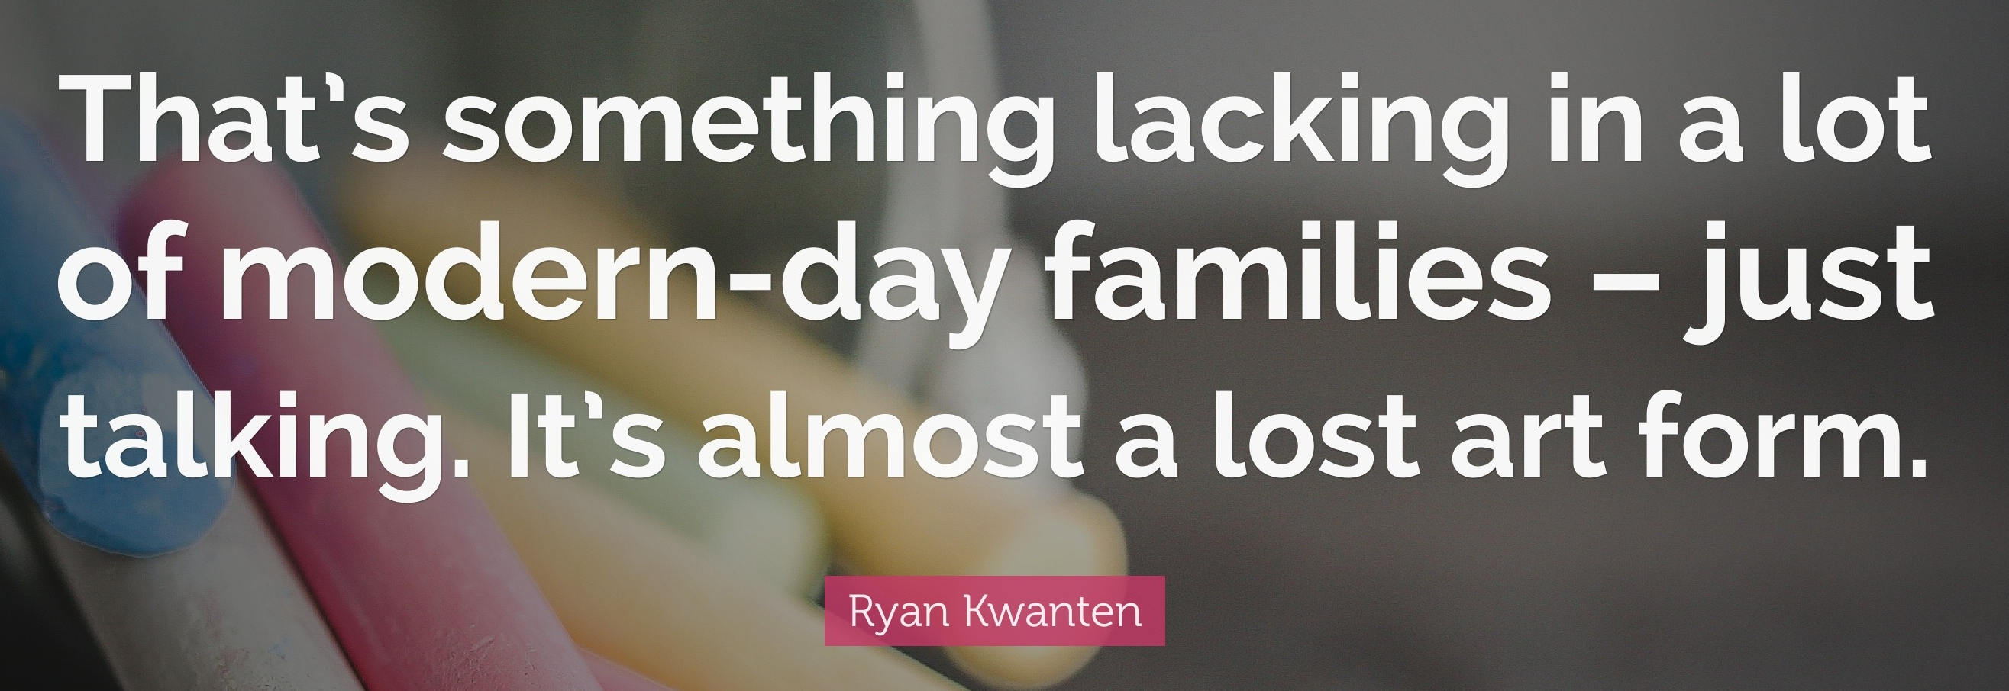
What you can do to help develop comprehension…
Comprehension of the world will develop comprehension in reading…
Ways you can develop comprehension –
  Talking a lot at home… about everything
  Develop cultural capital by going out (this does not have to cost money)
  Reading together and discussing books together
    Why do you like this book?
    What do you think will happen next?
    What do you think about this character?

Slide 14
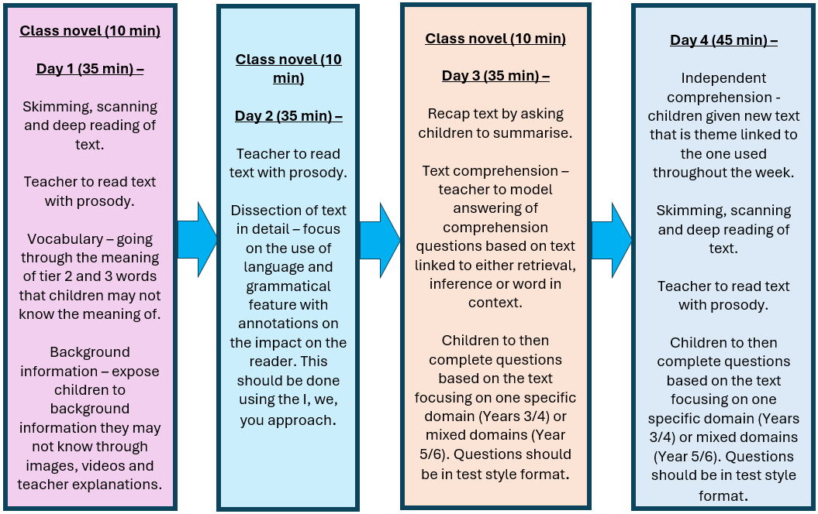
How do we teach comprehension in school? A more formal process…

Slide 15
Vocabulary -
Interpreting words in context and deciphering the meaning of words unknown based on the context they are written.
Mr Ali loathes wearing a tie as he finds it uncomfortable.
We may not know the meaning of the word ‘loathe’ here but based on the context and other evidence within the sentence, we can guess it means ‘doesn’t like’. How have I arrived at this conclusion?
Beowulf was incensed by Grendel’s attack and vowed revenge.
We may not know the meaning of the word ‘incensed’ here but we can guess it means ‘angered’. How have I arrived at this conclusion?

Slide 16
Retrieve
Retrieval of information is often the starting point for discussing a text. This means picking the exact (spelling and punctuation too) information out of the text that they have just read. E.g.
What was the character’s name?
What did they eat for dinner?
What colour was the car?
What time did…
Summary -
Summarise main ideas from more than one paragraph
  What is the main point of the first paragraph?
  What heading would be appropriate for this paragraph?

Slide 17
Inference: is an interpretation that goes beyond the literal information given and relies on the evidence within the text as well as background knowledge.
The police find a threatening letter addressed to the victim.
We could infer that someone didn’t like that person.
The bike lay on the floor next to her as she held her leg and cried.
We could infer that the girl fell off her bike.
My stomach rumbled as the smell of dinner wafted from the kitchen.
We could infer that this person is hungry.

Slide 18
Predict – what has or what will happen based on information stated or inferred (linked closely to inference). Again, background knowledge here is important.
Beowulf snatched his sword from the armoury and ran towards the mountains.
  What do predict Beowulf is going to do? What evidence have you used to make your prediction?
Mr Ali woke up with a terrible headache and severe cough. He picked up his mobile and began to dial.
  Who do you think Mr Ali is going to call? Why?
Predictions, like inferences are neither right or wrong, they may be strong (with secure evidence to back them up) or weak (with little or poor evidence to back them up).

Slide 19
Explain –
Identify/explain how information/narrative content is related and contributes to the meaning as a whole.
Identify/explain how meaning is enhanced through choice of words and phrases.
Make comparisons within the text.
***See handout for example questions***

Slide 20
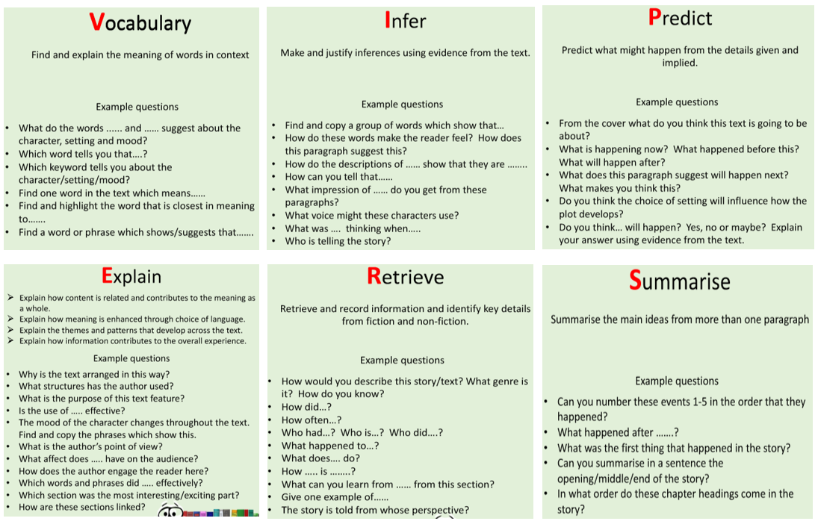
Questions you can ask at home…

Slide 21
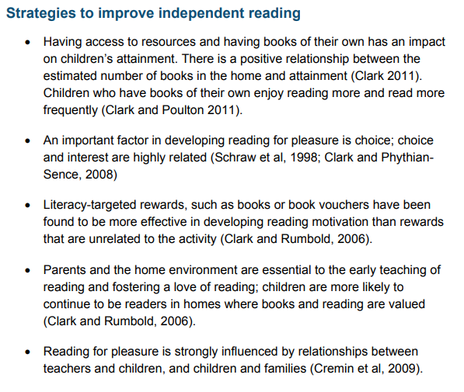
How to encourage independent reading at home
Having books that the child owns
Using the library to help build variety
Exposing children to texts beyond novel. E.g. comics, magazines, non-fiction books
Taking control of screens – reading first and then screentime
Show that you love reading… even if you have to fake it
Give children books that matter to them (BAME authors and characters, texts that excite them
Reward reading through extrinsic and intrinsic motivators

Slide 22
Websites
100 best books for children | BookTrust
What to read after your favourite children's books and authors | BookTrust
Great Books Guide: 100 best new books for children | BookTrust
Book Reviews, Kids Books | Common Sense Media

Slide 23
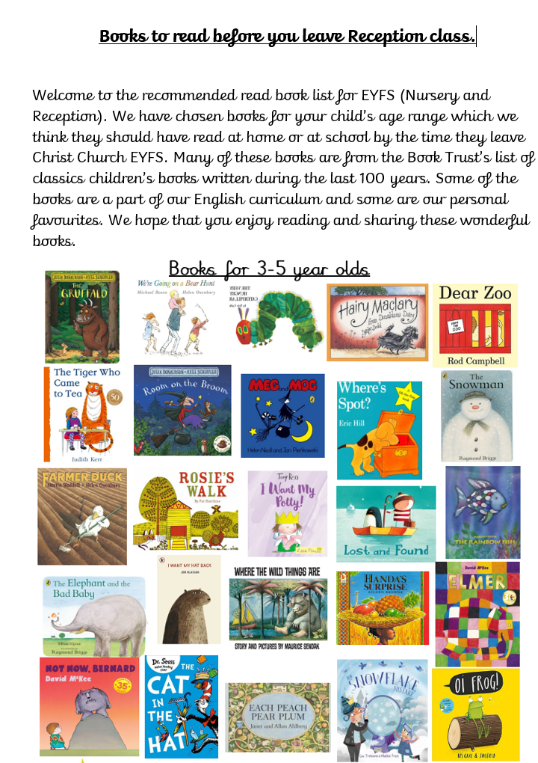

Slide 24
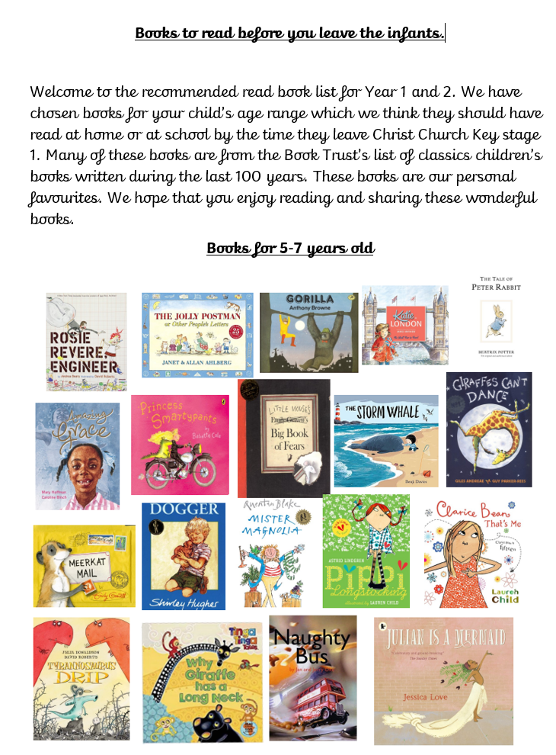

Slide 25
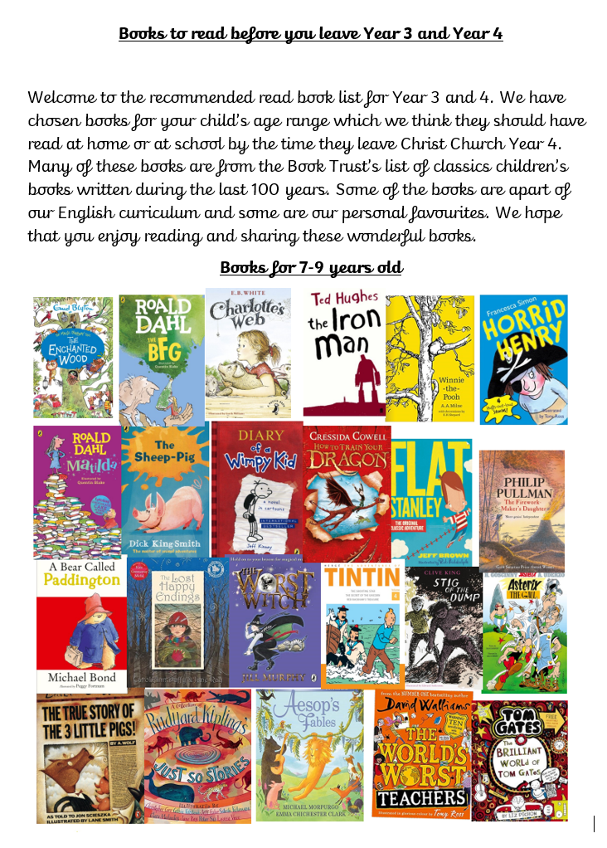

Slide 26
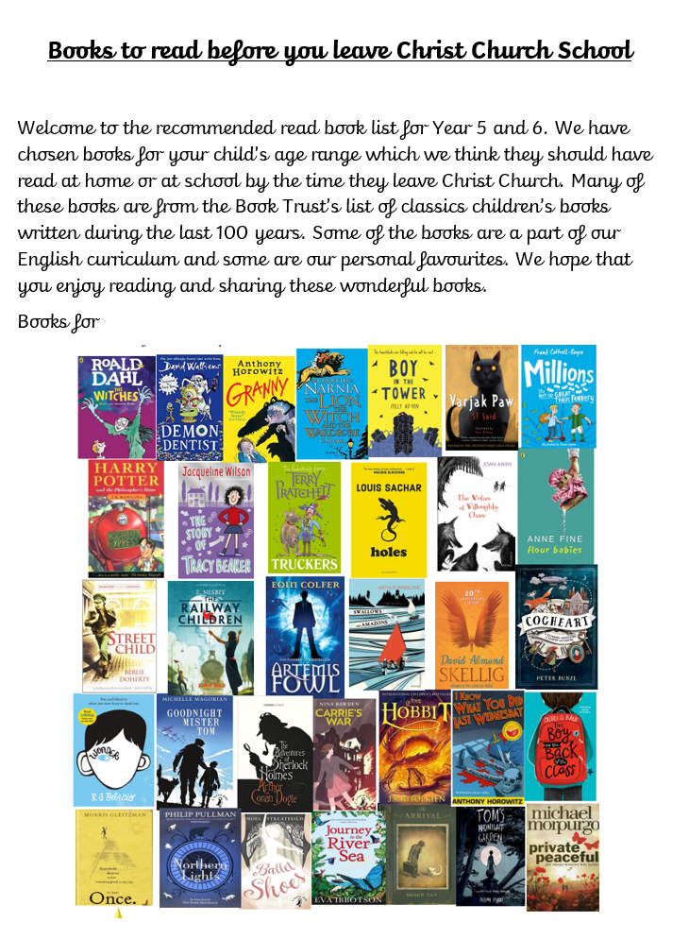

Slide 27
Any questions?

